Slide 1
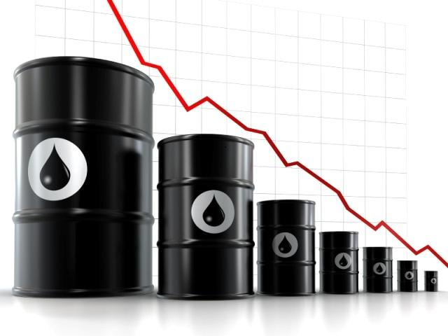
Time Series Forecast for Gas Price
Zihe Yang (zy151)
Xueyan Liu (xl491)
Jiamin Zhong(jz644)

Slide 2
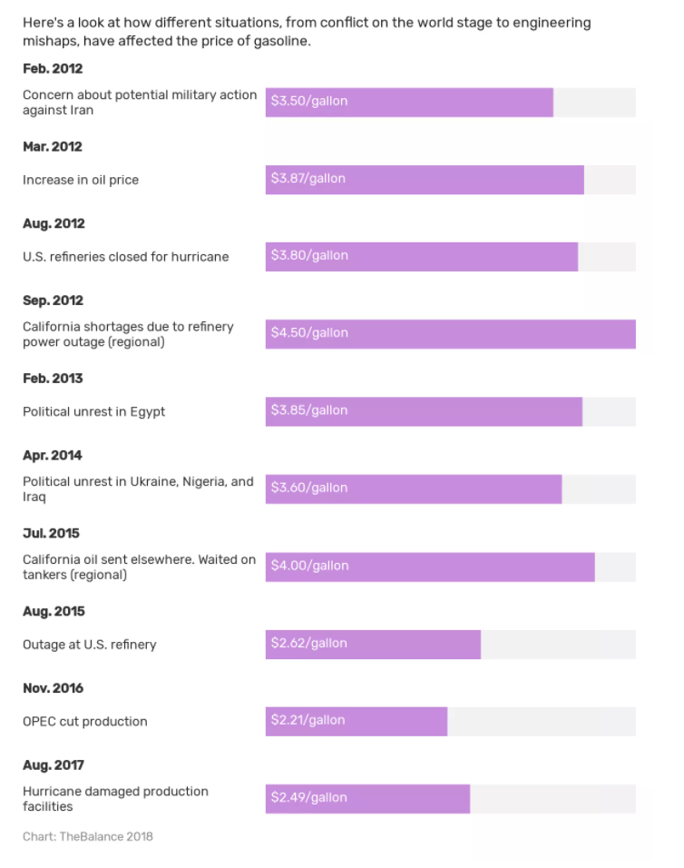

Slide 3


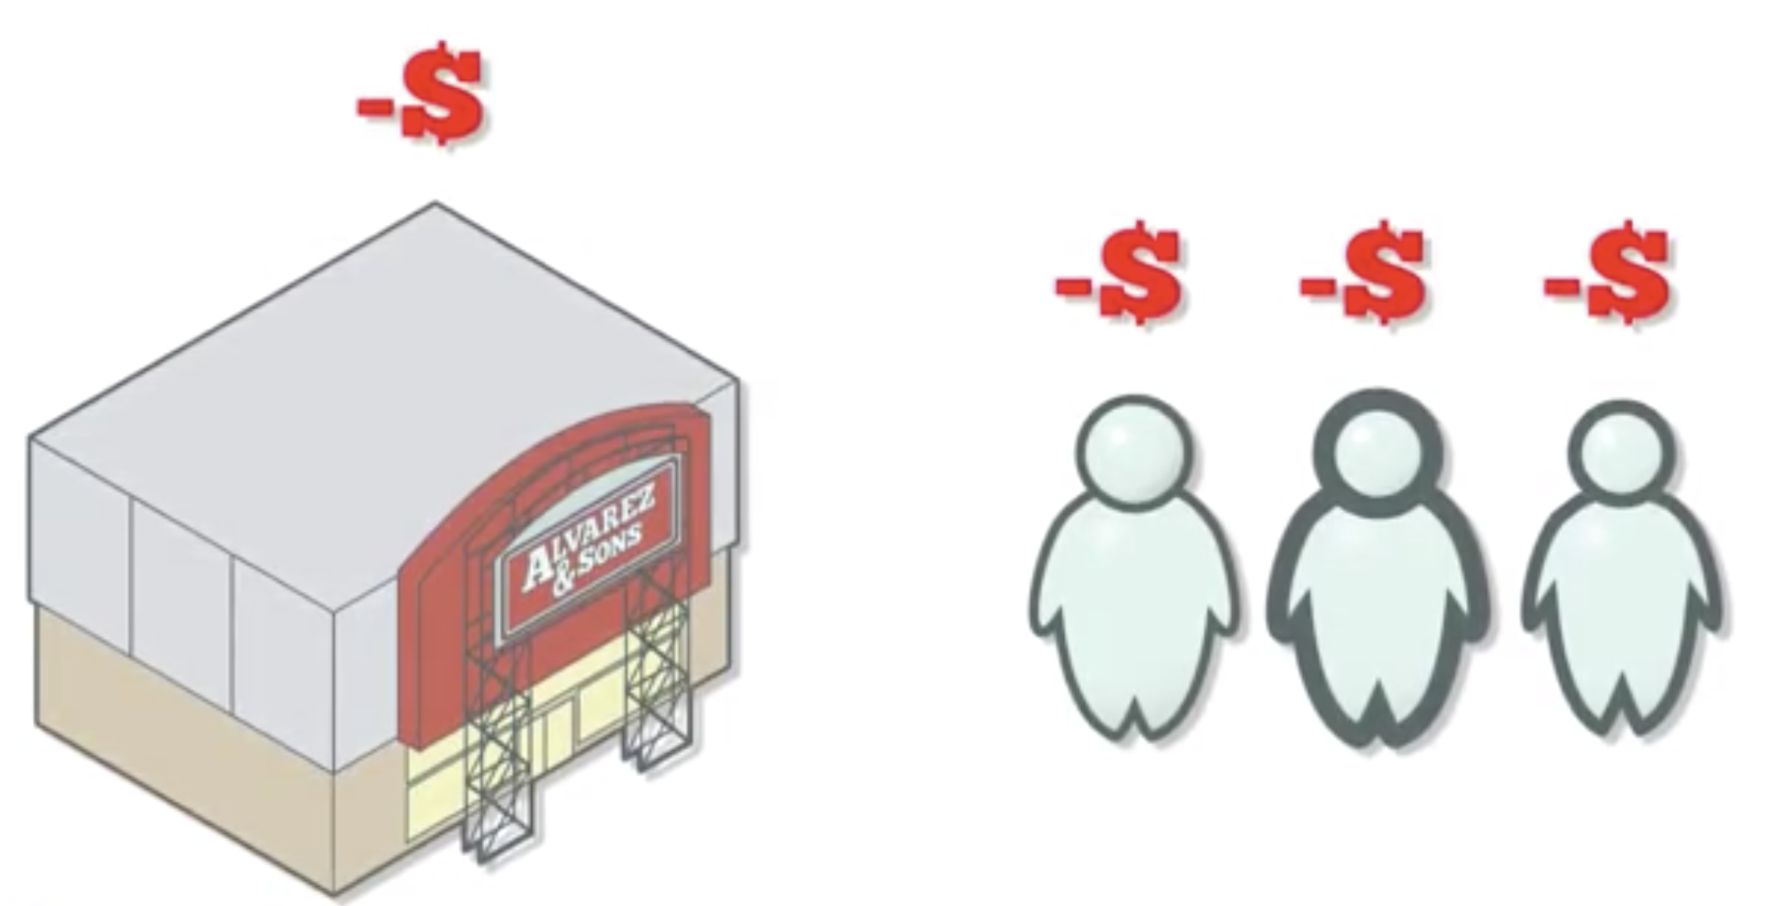
If gas price is higher ...
Individuals:
Pay more on gas, less on others
Retailers
Suffer with less shoppers
Online shopping
Higher cost of shipping
Jobs
Lower sales, lower workers needed
Airlines ...

Slide 4
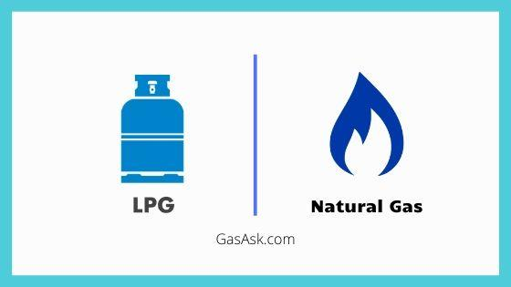

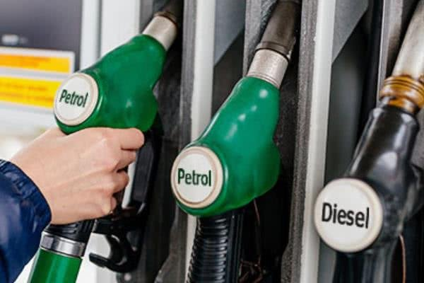
Dataset - Gas Prices in Brazil
Cooking & Heating
Weekly reports of gas prices
From 2004 to 2019
785 Records
Average Price, Min Price, Max Price
5 Gas
Regular Gasoline
Diesel
Hydrous Ethanol
Natural Gas
LPG
Transportation

Slide 5

EDA

Slide 6
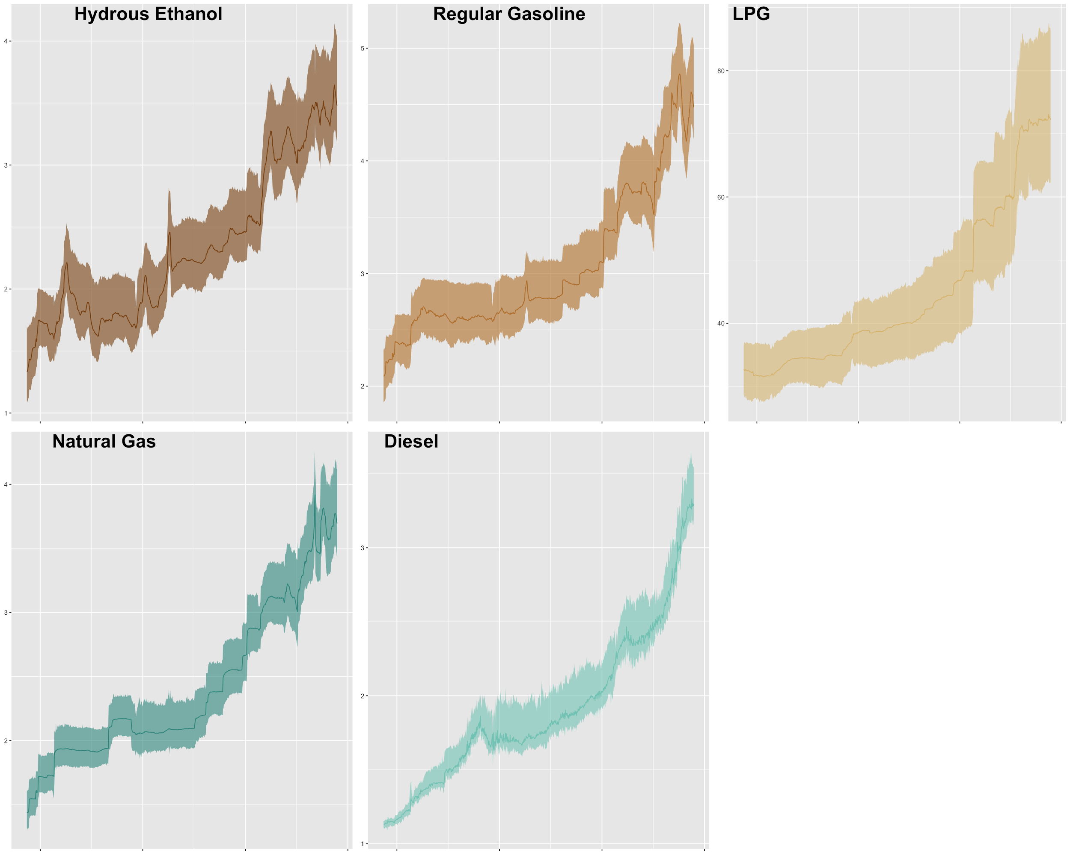
Products’
Average Price per week with Max and Min range

Slide 7
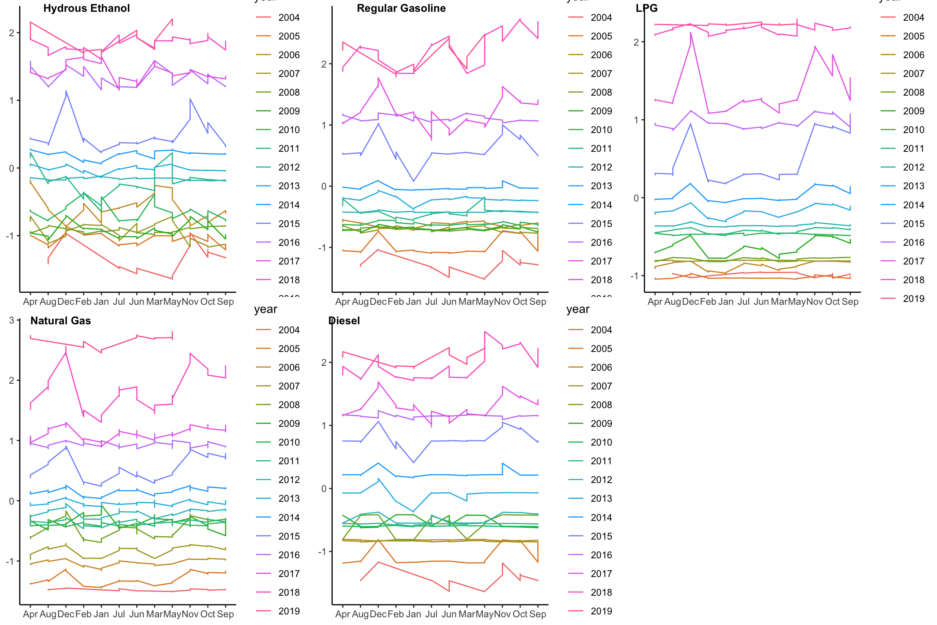
Each product's yearly gas price
Notes:
Stable within each of the years
Gradually increasing over the years
Product correlation

Slide 8
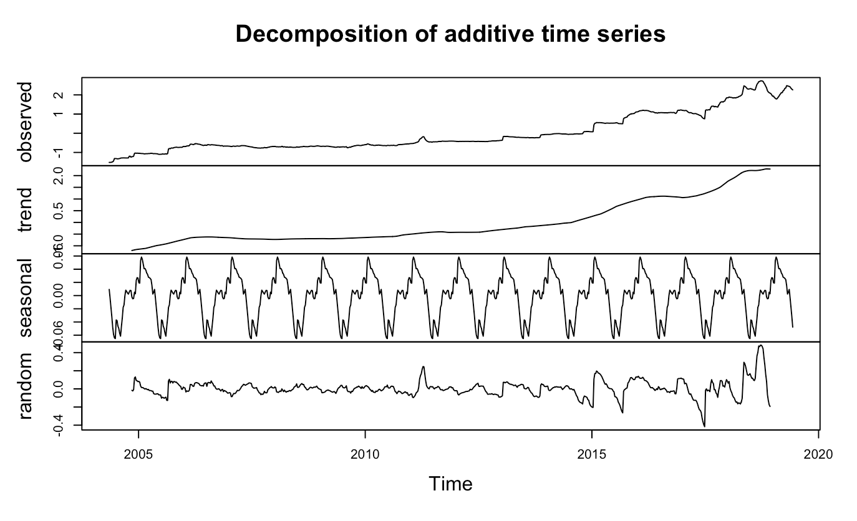
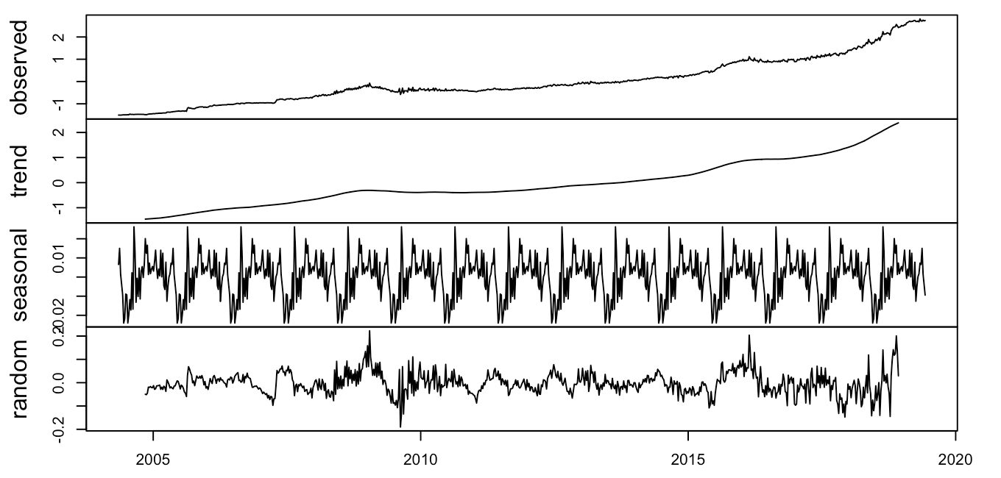
Decomposition
Regular Gasoline
Natural Gas
Notes:
Upward trend

Slide 9
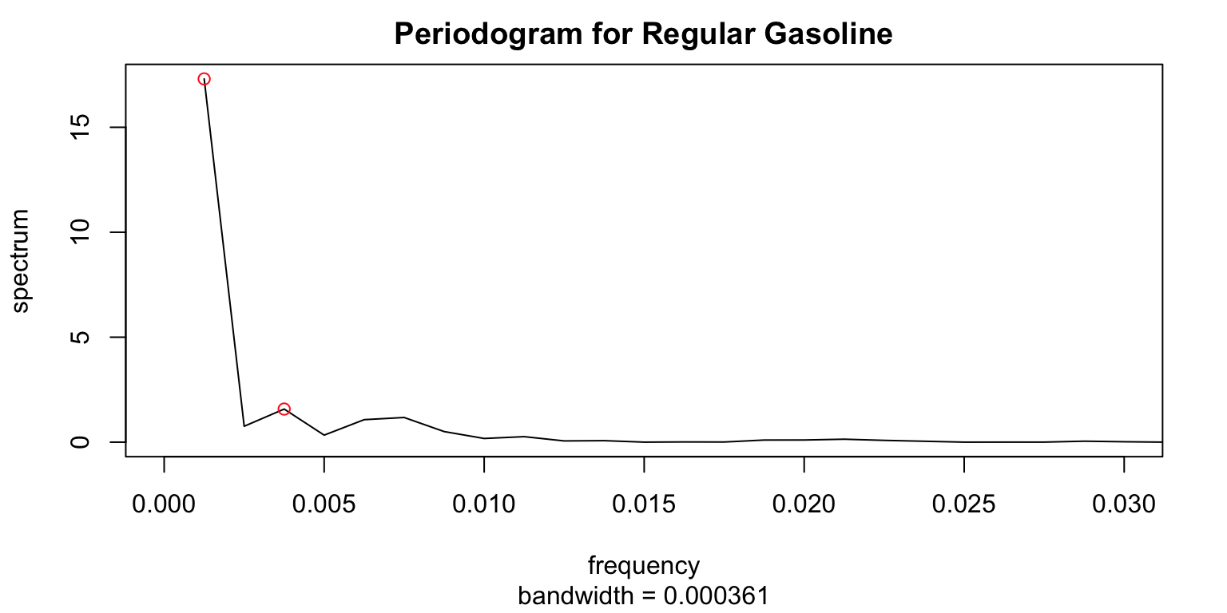
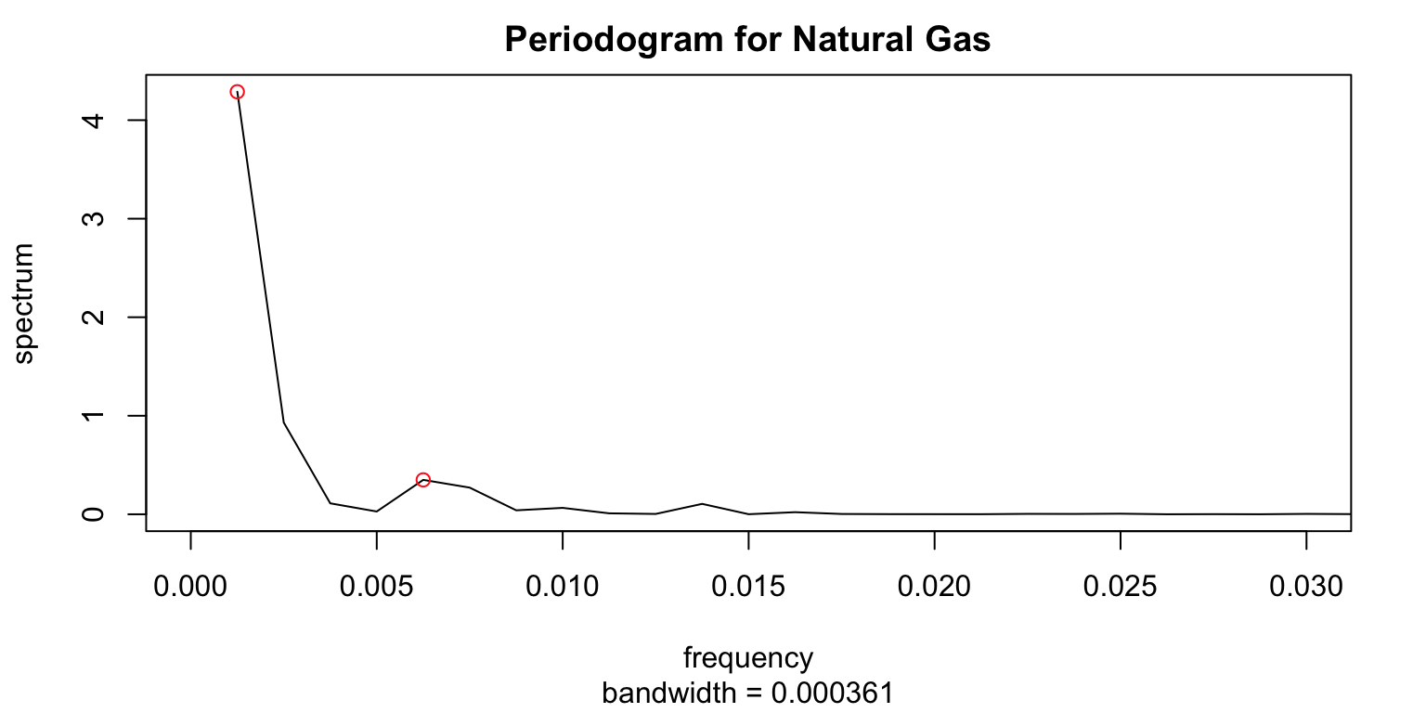
Frequency Analysis
Frequency 1: 0.00125
800 weeks pre cycle
Frequency 2: 0.00375
260 weeks pre cycle
Notes:
Long and weak seasonality

Slide 10
Prediction
Periodic Analysis
Time Series Analysis
Multivariate Analysis
Arima Model
Garch Volatility clustering
Arima Modeling
with Fourier Term
Vector Autoregression with trends

Slide 11
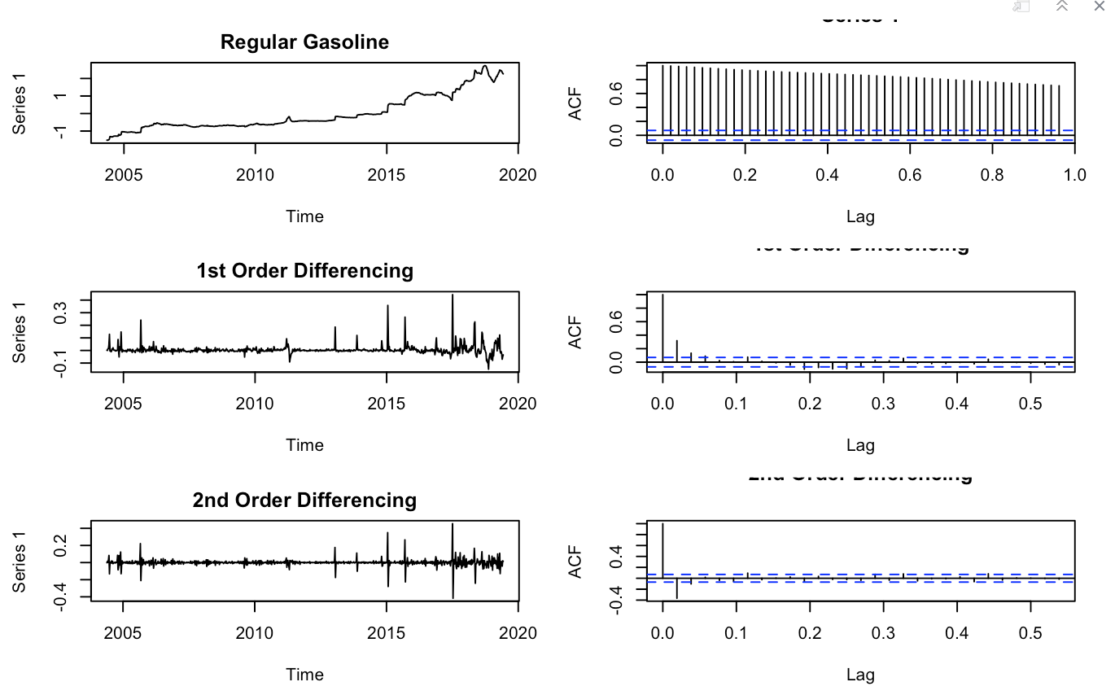
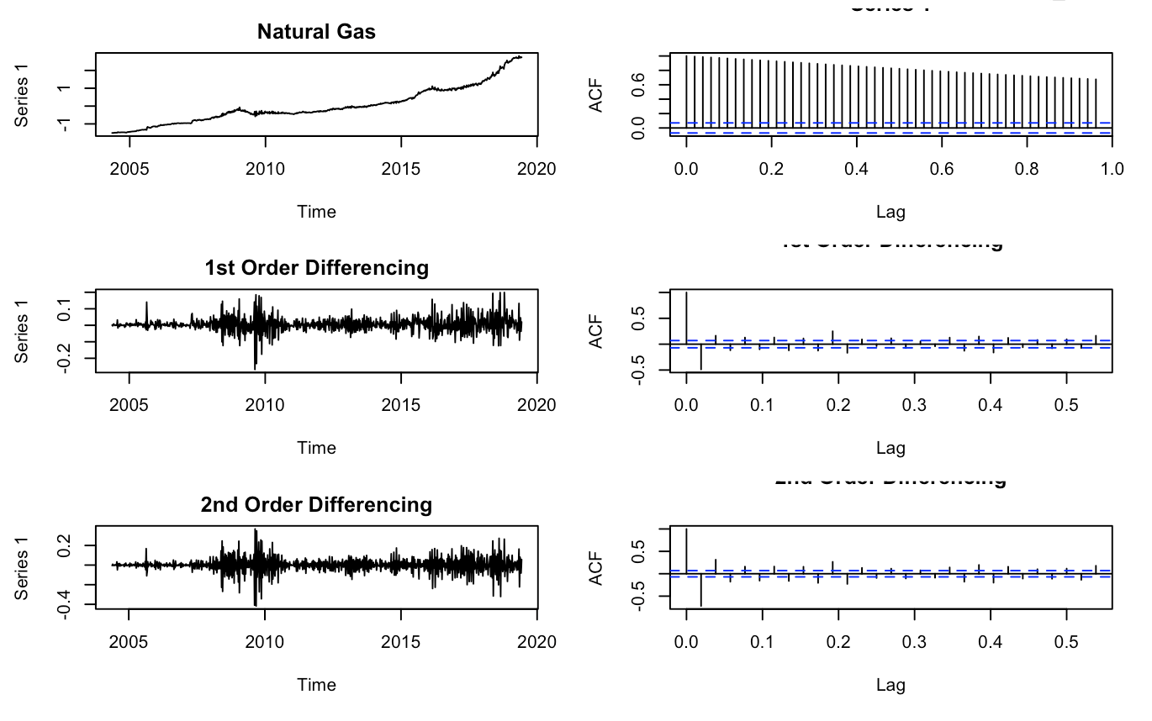
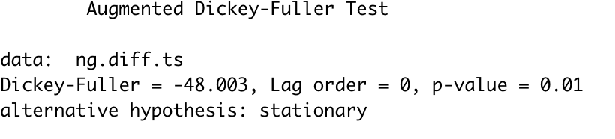
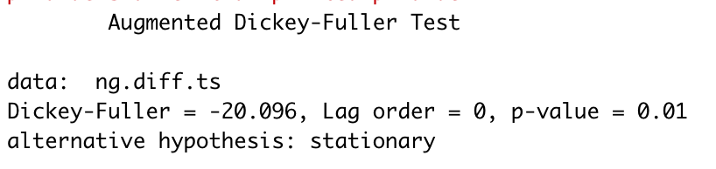
Model Selection - Stationarity

Slide 12
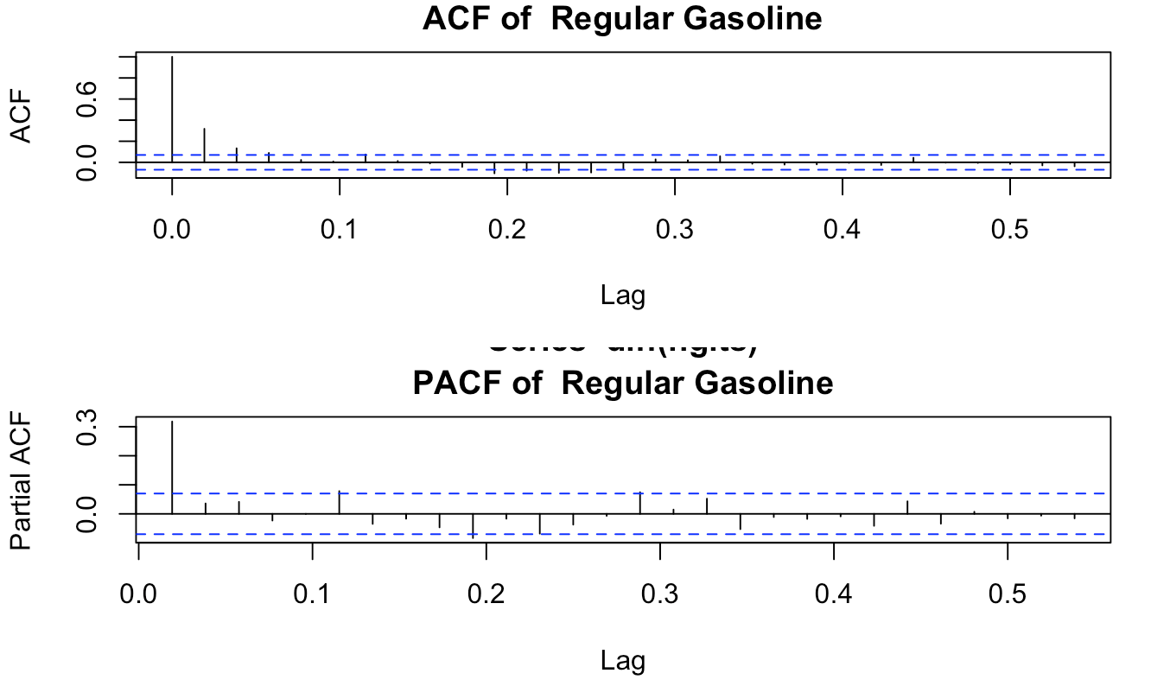
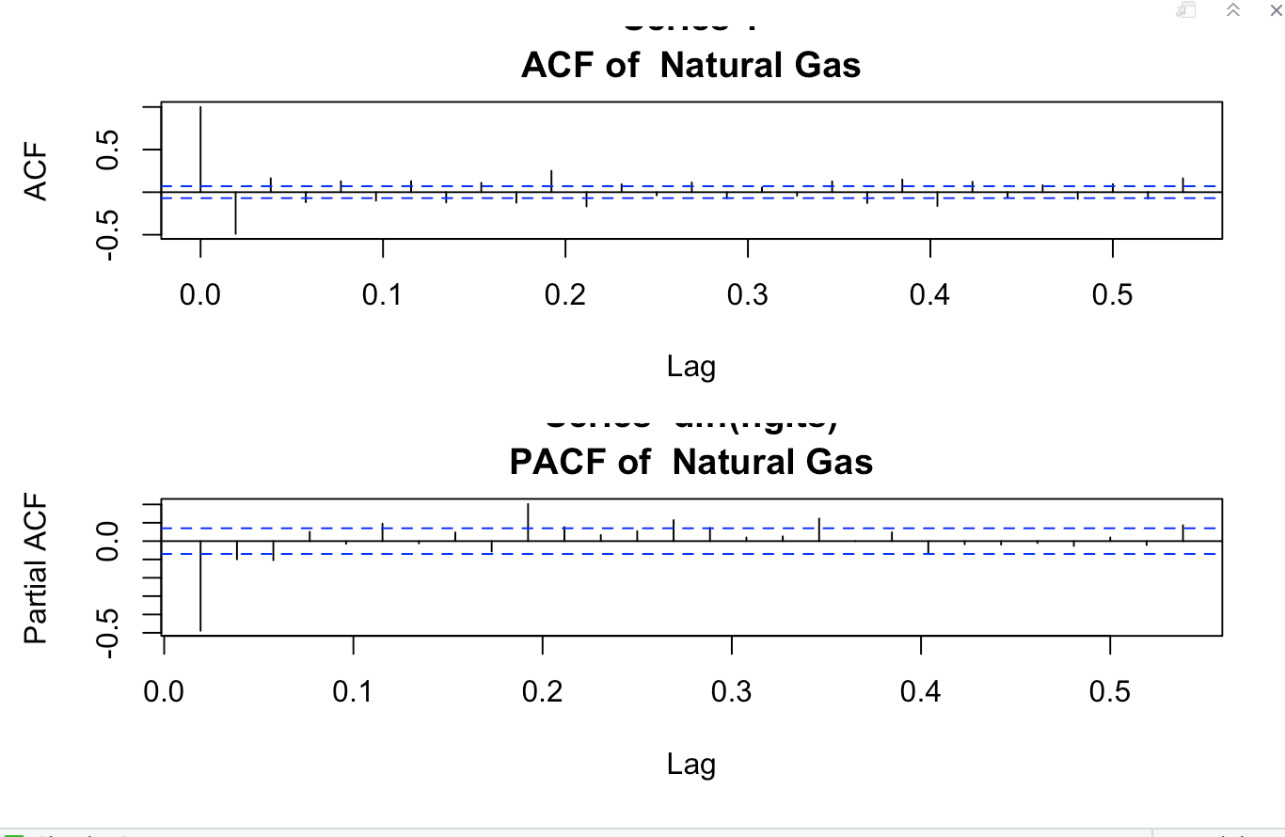
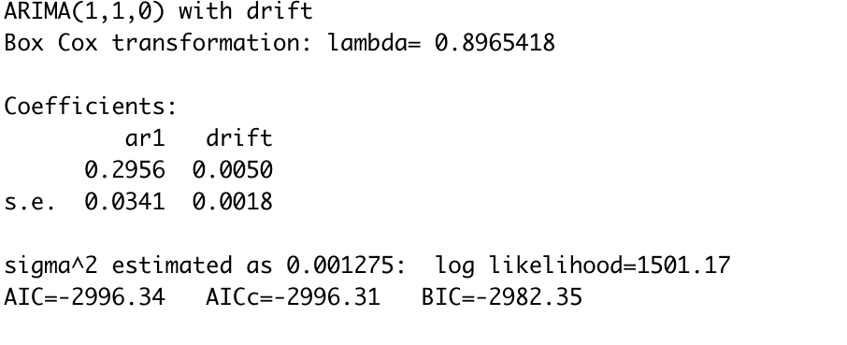
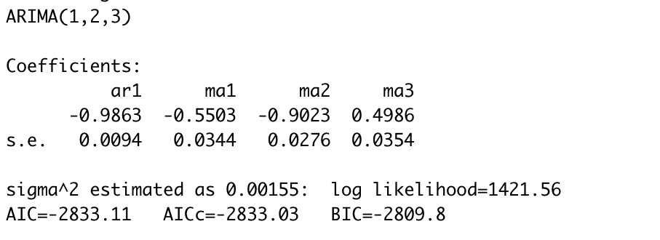
Model Selection - ARIMA(p, d, q)

Slide 13
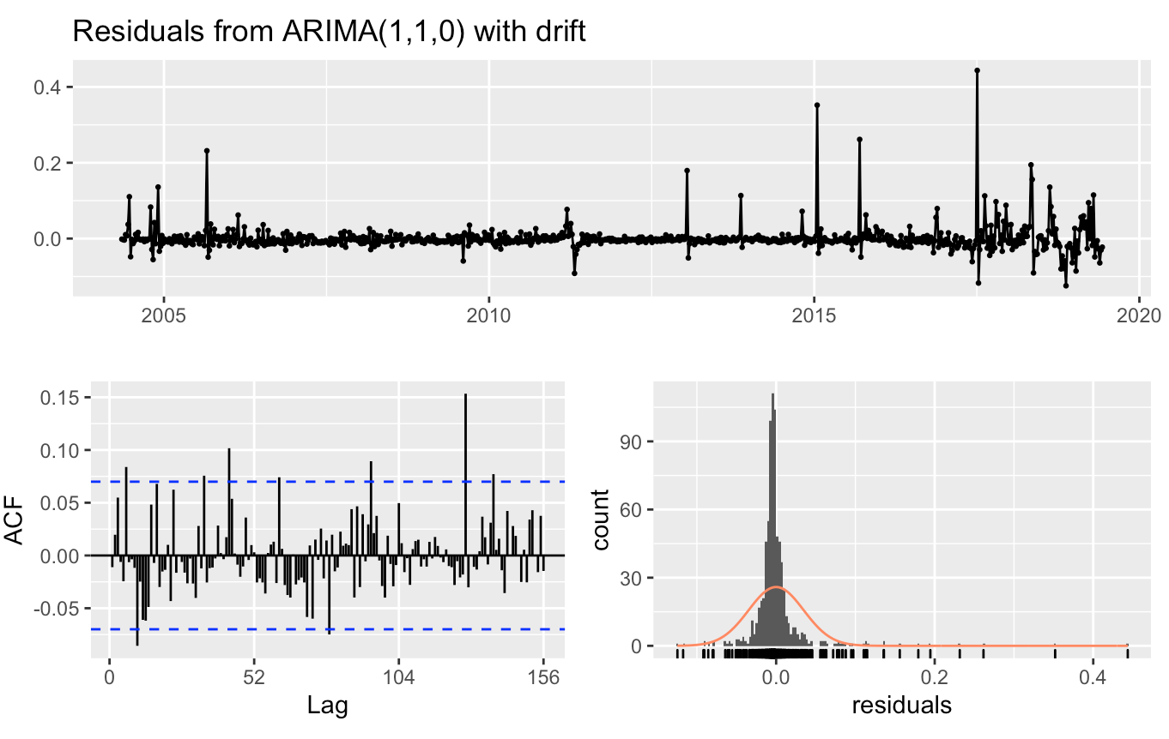
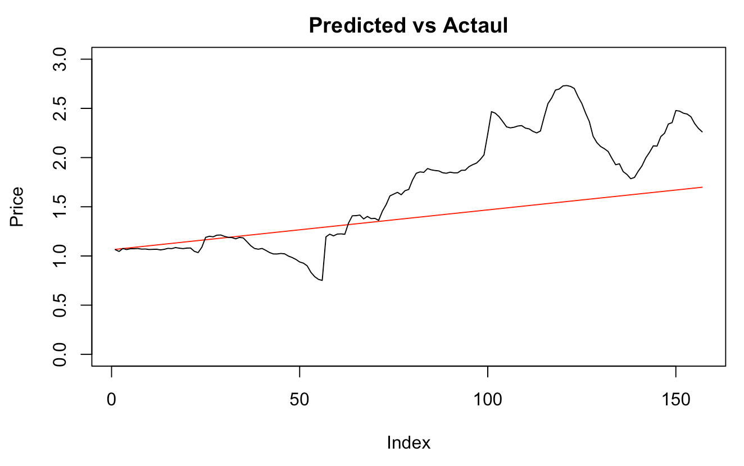
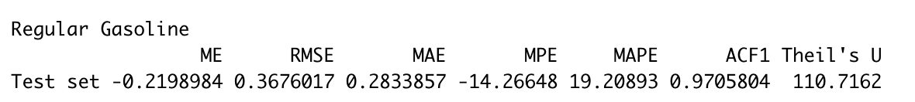
Model Diagnostics - Regular Gas
Notes:
Look at the plot of the standardized residuals: Do we see volatility clustering –> nonconstant variance?
Let’s look at the ACF and PACF of the SQUARED residuals:

Slide 14
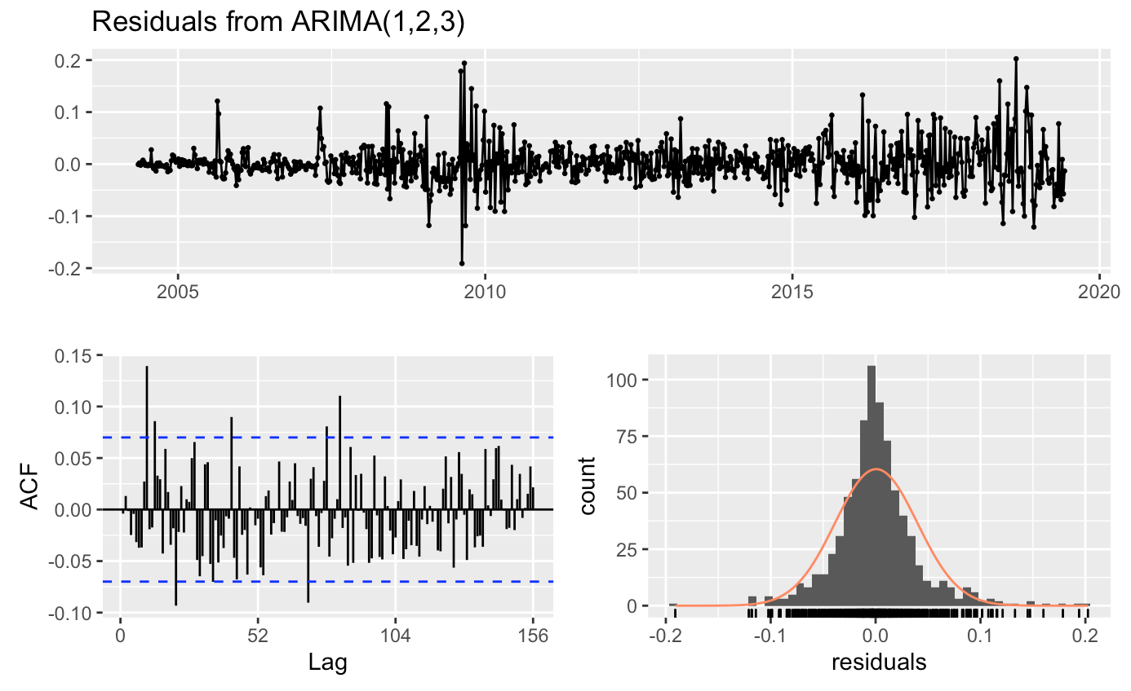
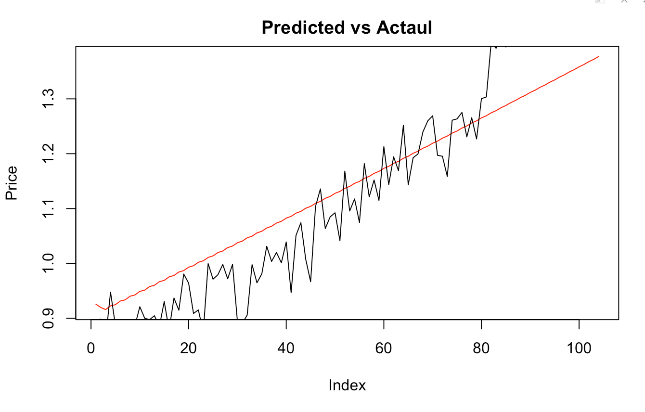
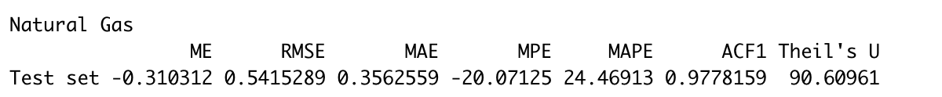
Model Diagnostics - Natural Gas
Notes:
Look at the plot of the standardized residuals: Do we see volatility clustering –> nonconstant variance?
Let’s look at the ACF and PACF of the SQUARED residuals:

Slide 15
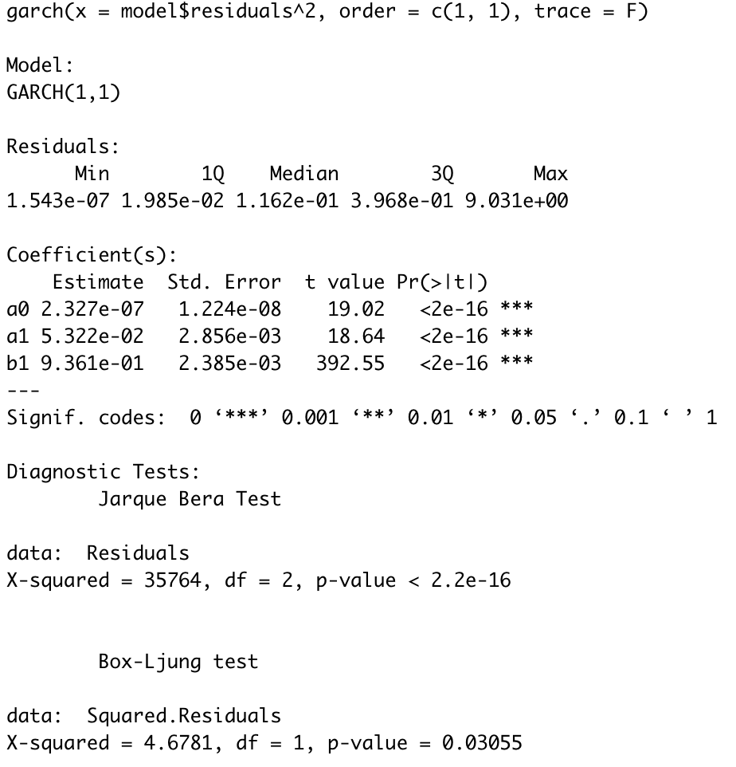
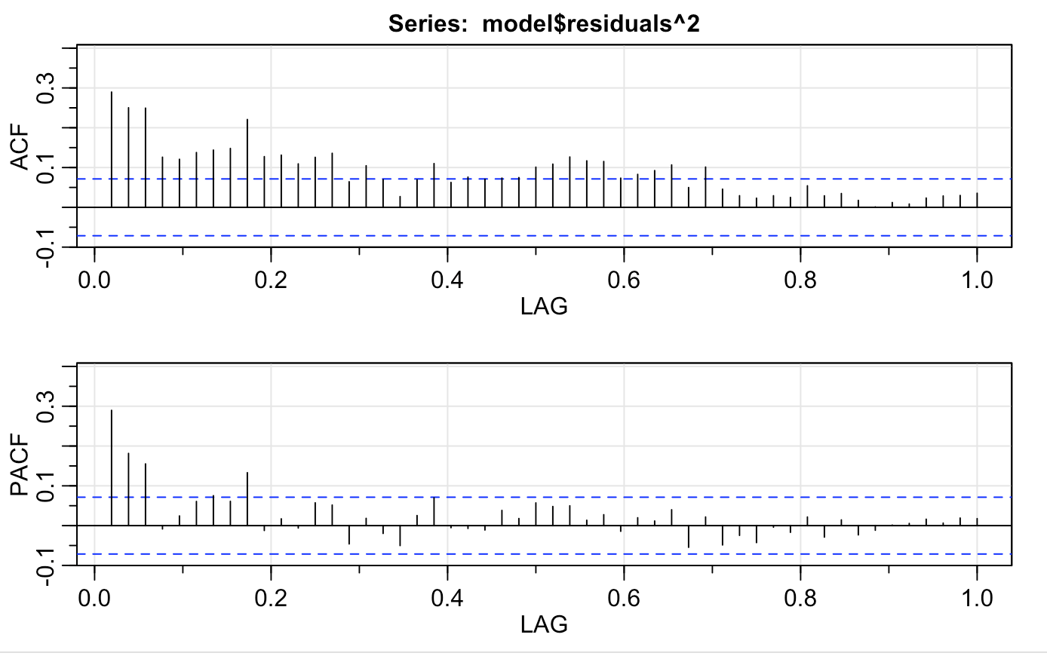
Volatility Clustering - Natural Gas

Slide 16
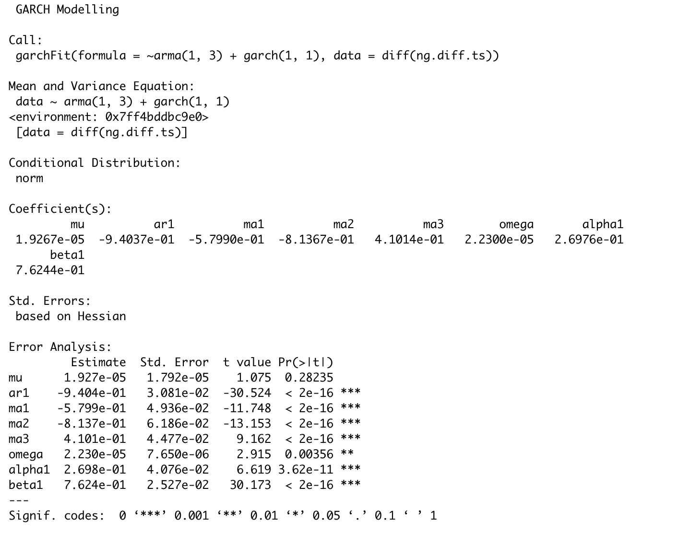
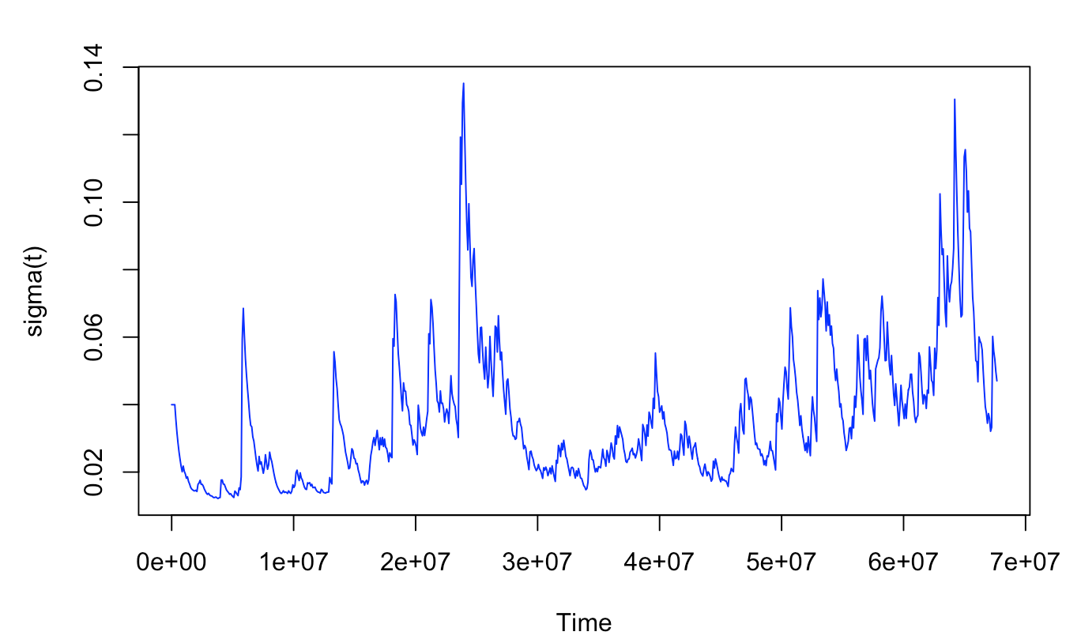
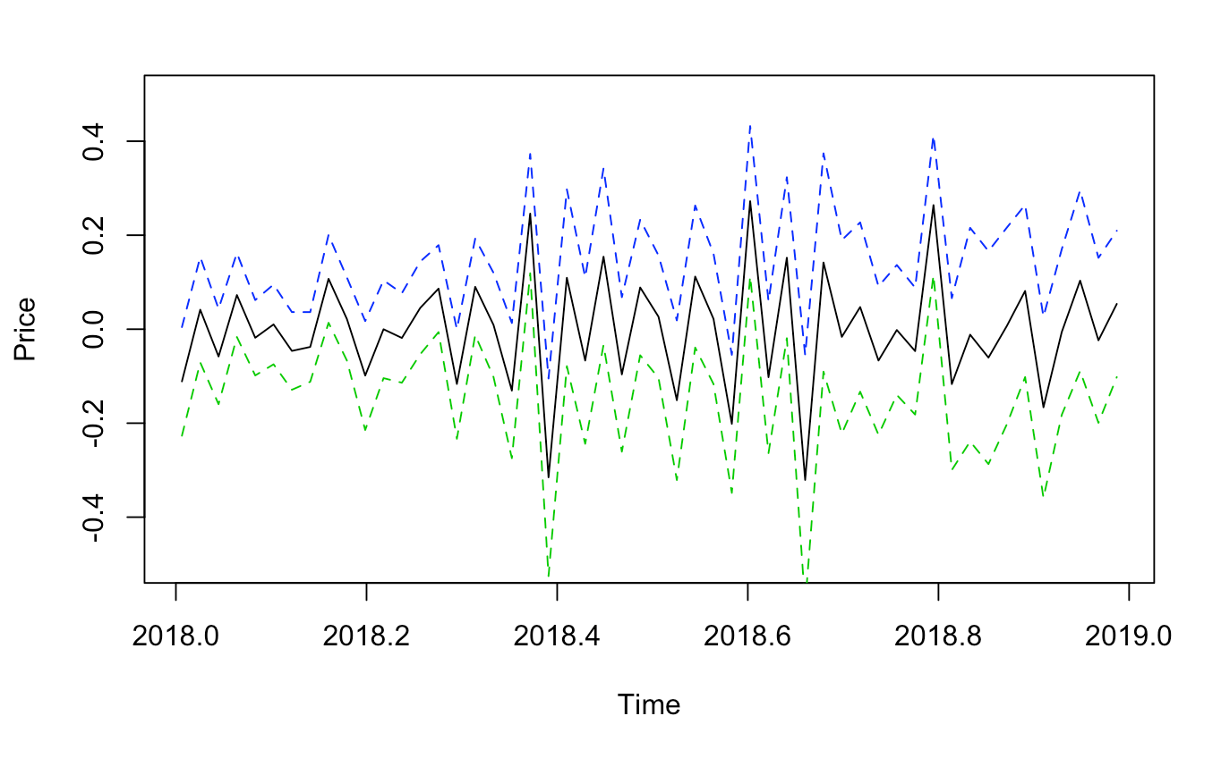
Volatility Clustering - Natural Gas

Slide 17
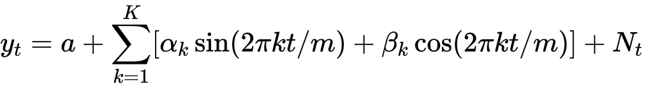
ARIMA with Fourier Terms
Notes:
It is a challenge to fit ARIMA model with data having a long seasonal period, such as daily or weekly data, since seasonal versions of ARIMA models are designed for shorter periods such as monthly or quarterly data. The problem is that there are m−1 parameters to be estimated for the initial seasonal states where m is the seasonal period. So for large m, the estimation becomes almost impossible. For such data we can use a Fourier series approach where the seasonal pattern is modelled using Fourier terms with short-term time series dynamics allowed in the error, although in this case the seasonality is assumed to be fixed, i.e. the pattern is not allowed to change over time.

Slide 18
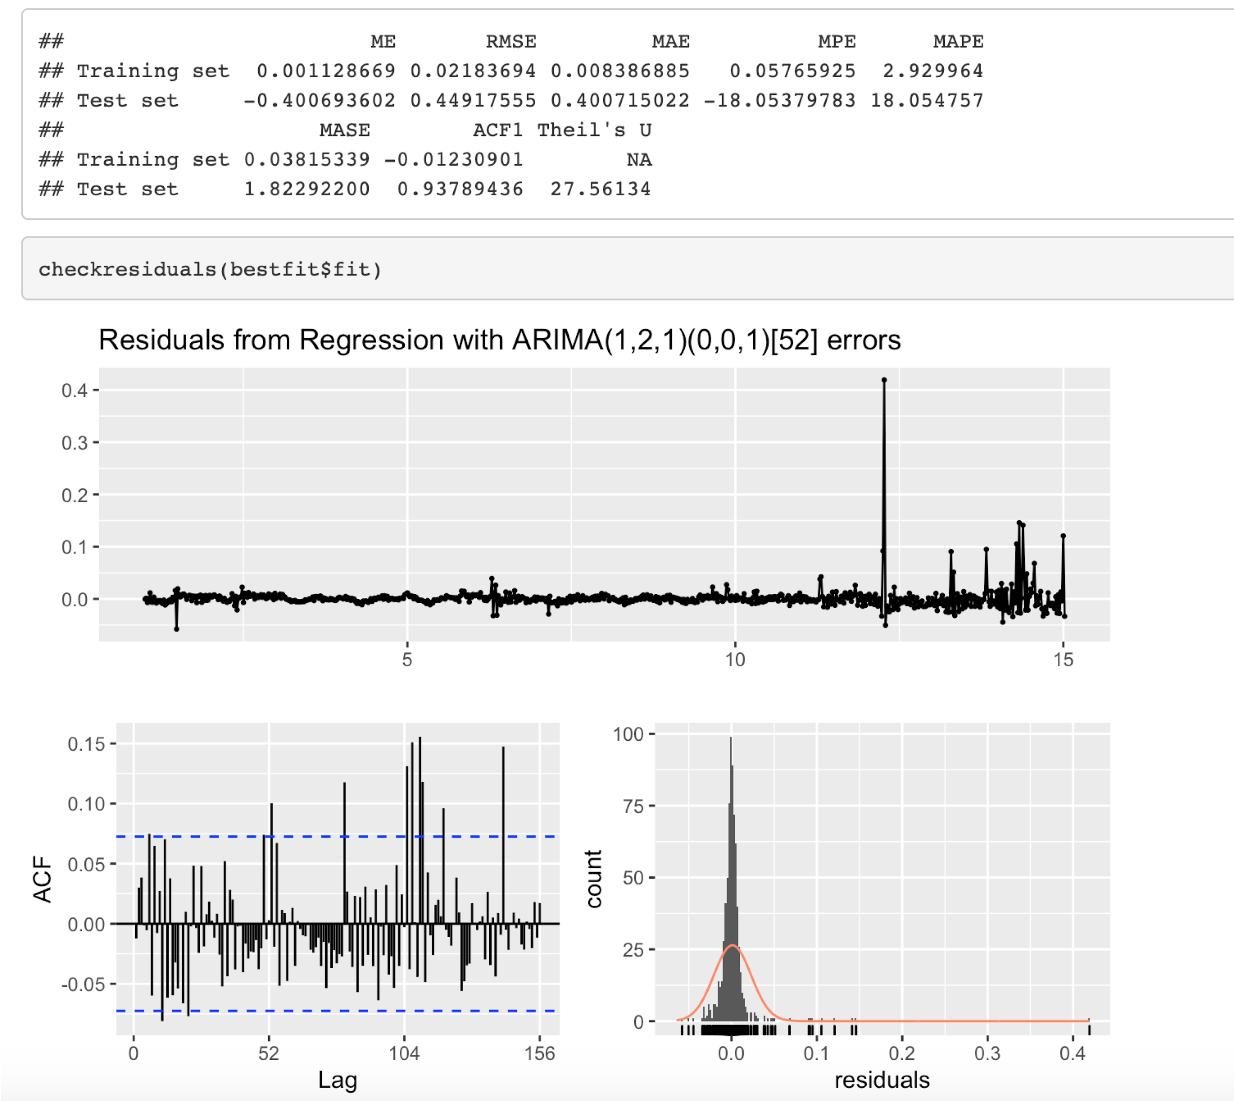
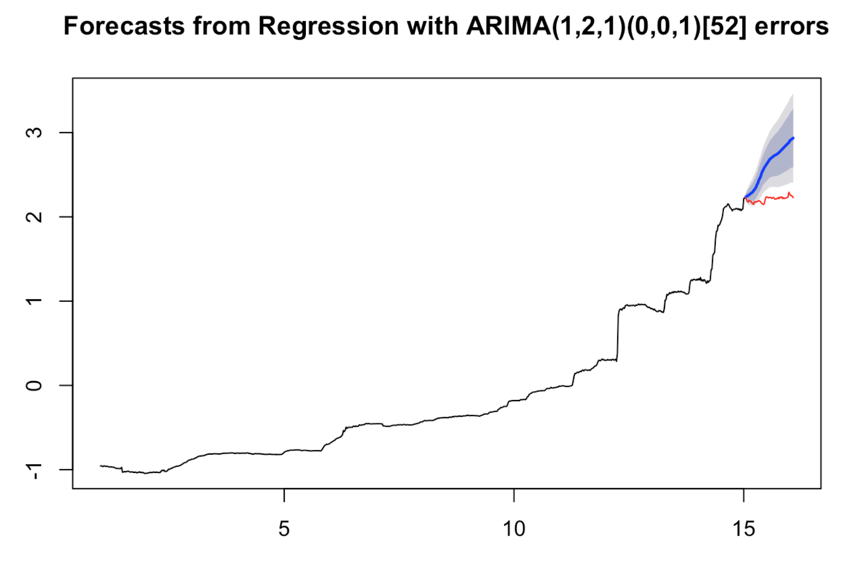
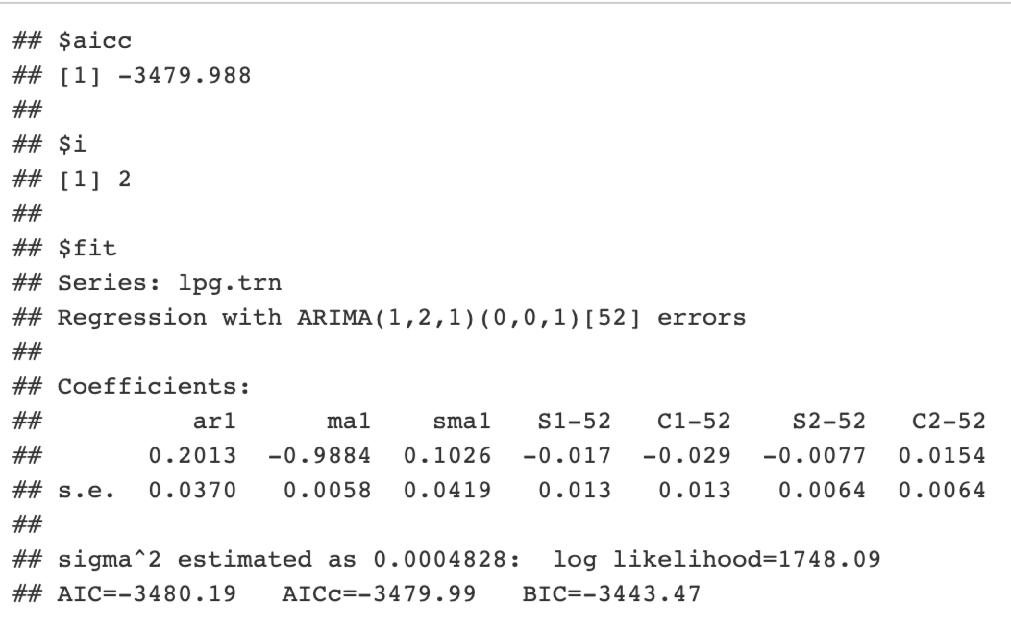
LPG
Notes:
k=2
p-value = 0.05519 => residuals non-stationary

Slide 19
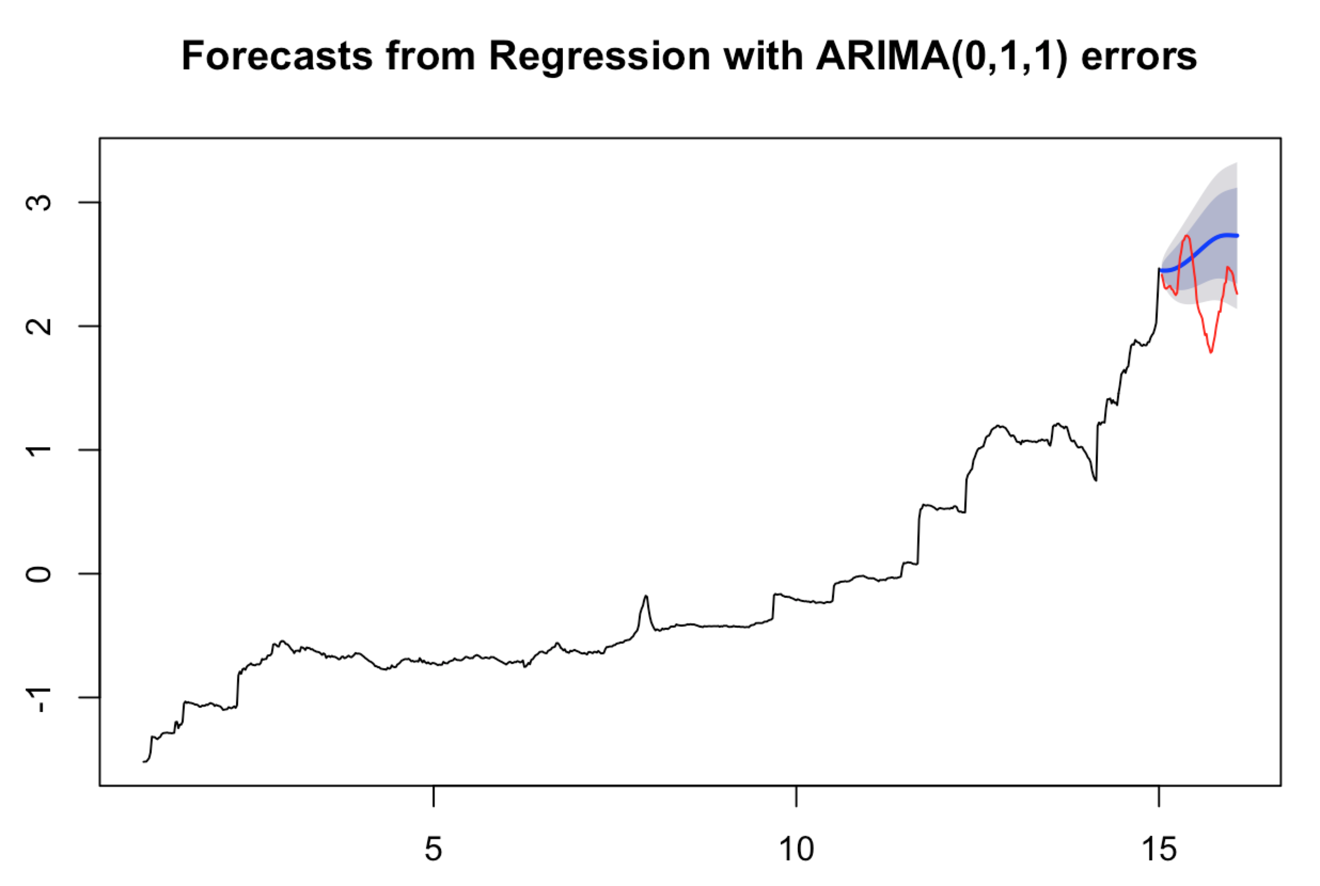
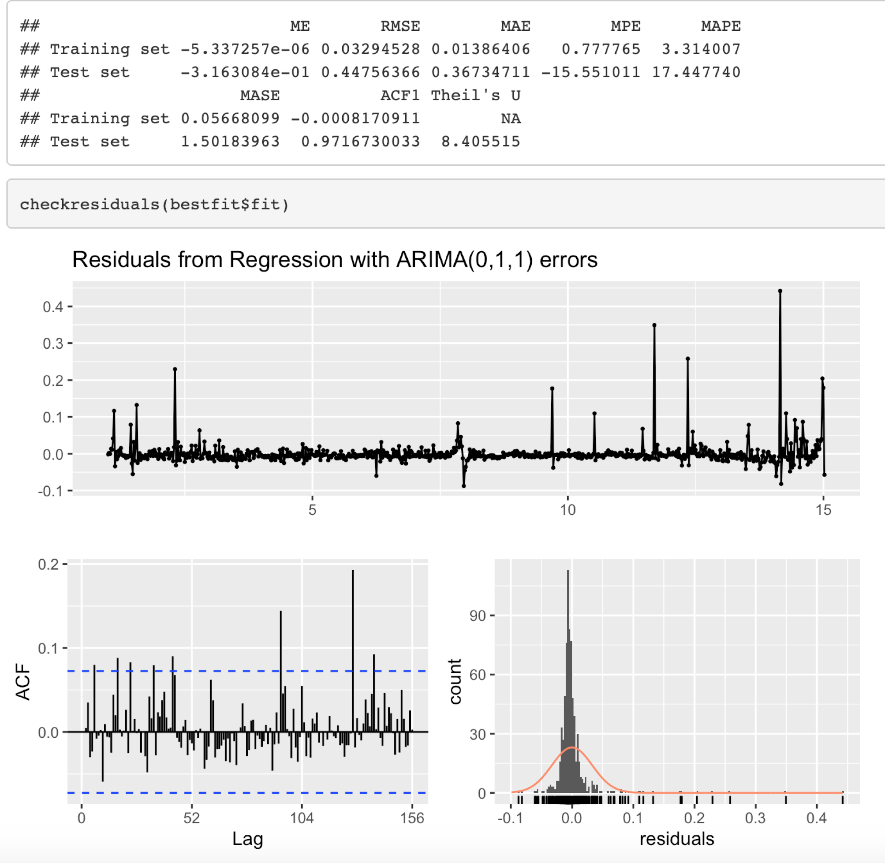
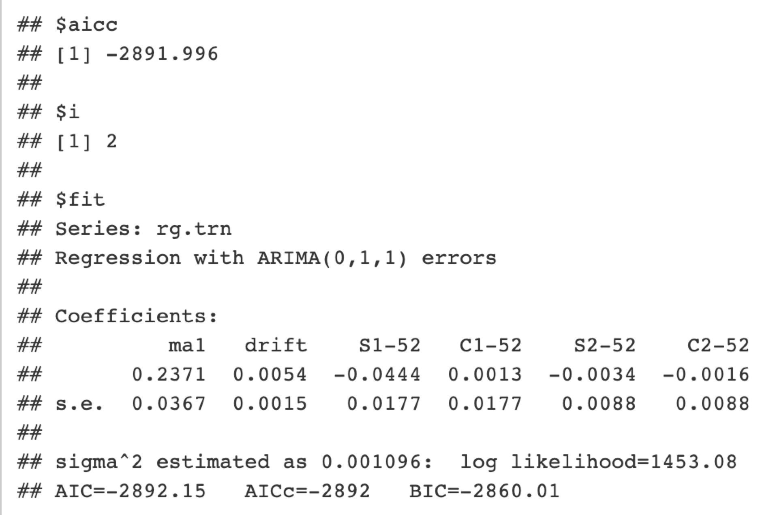
Regular Gasoline
Notes:
k=2
p-value = 0.5703 nonstationary

Slide 20
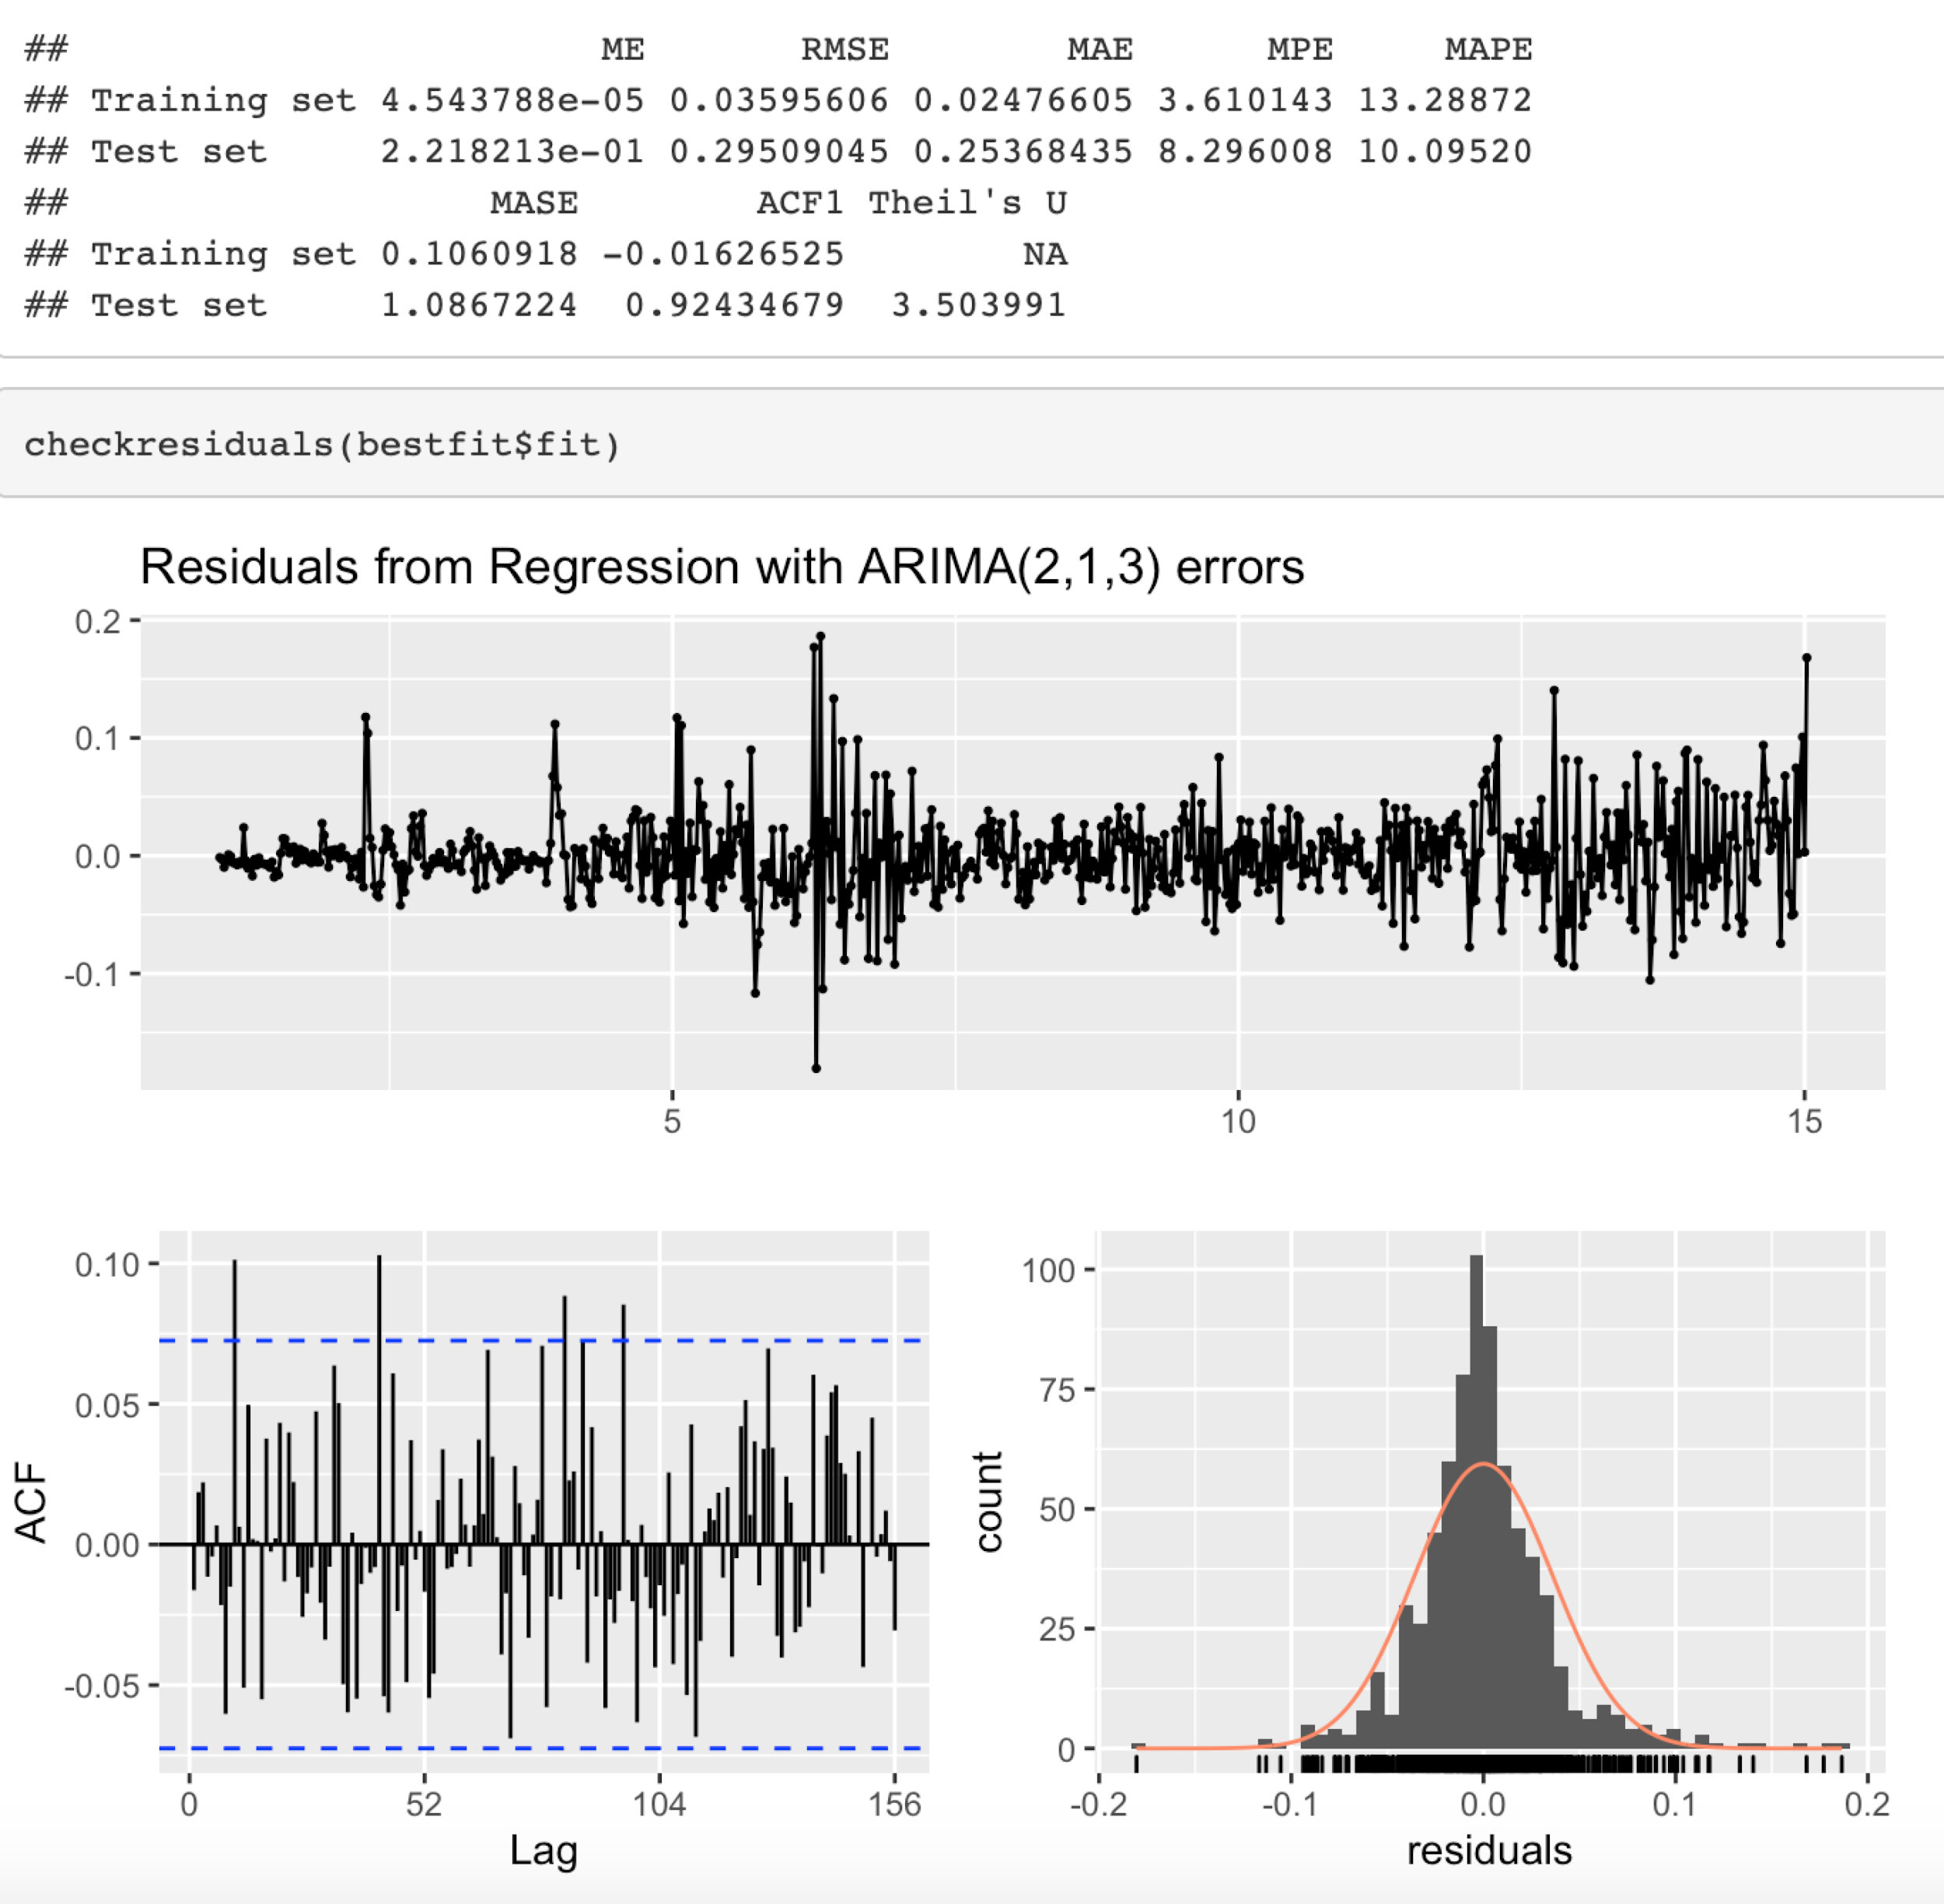
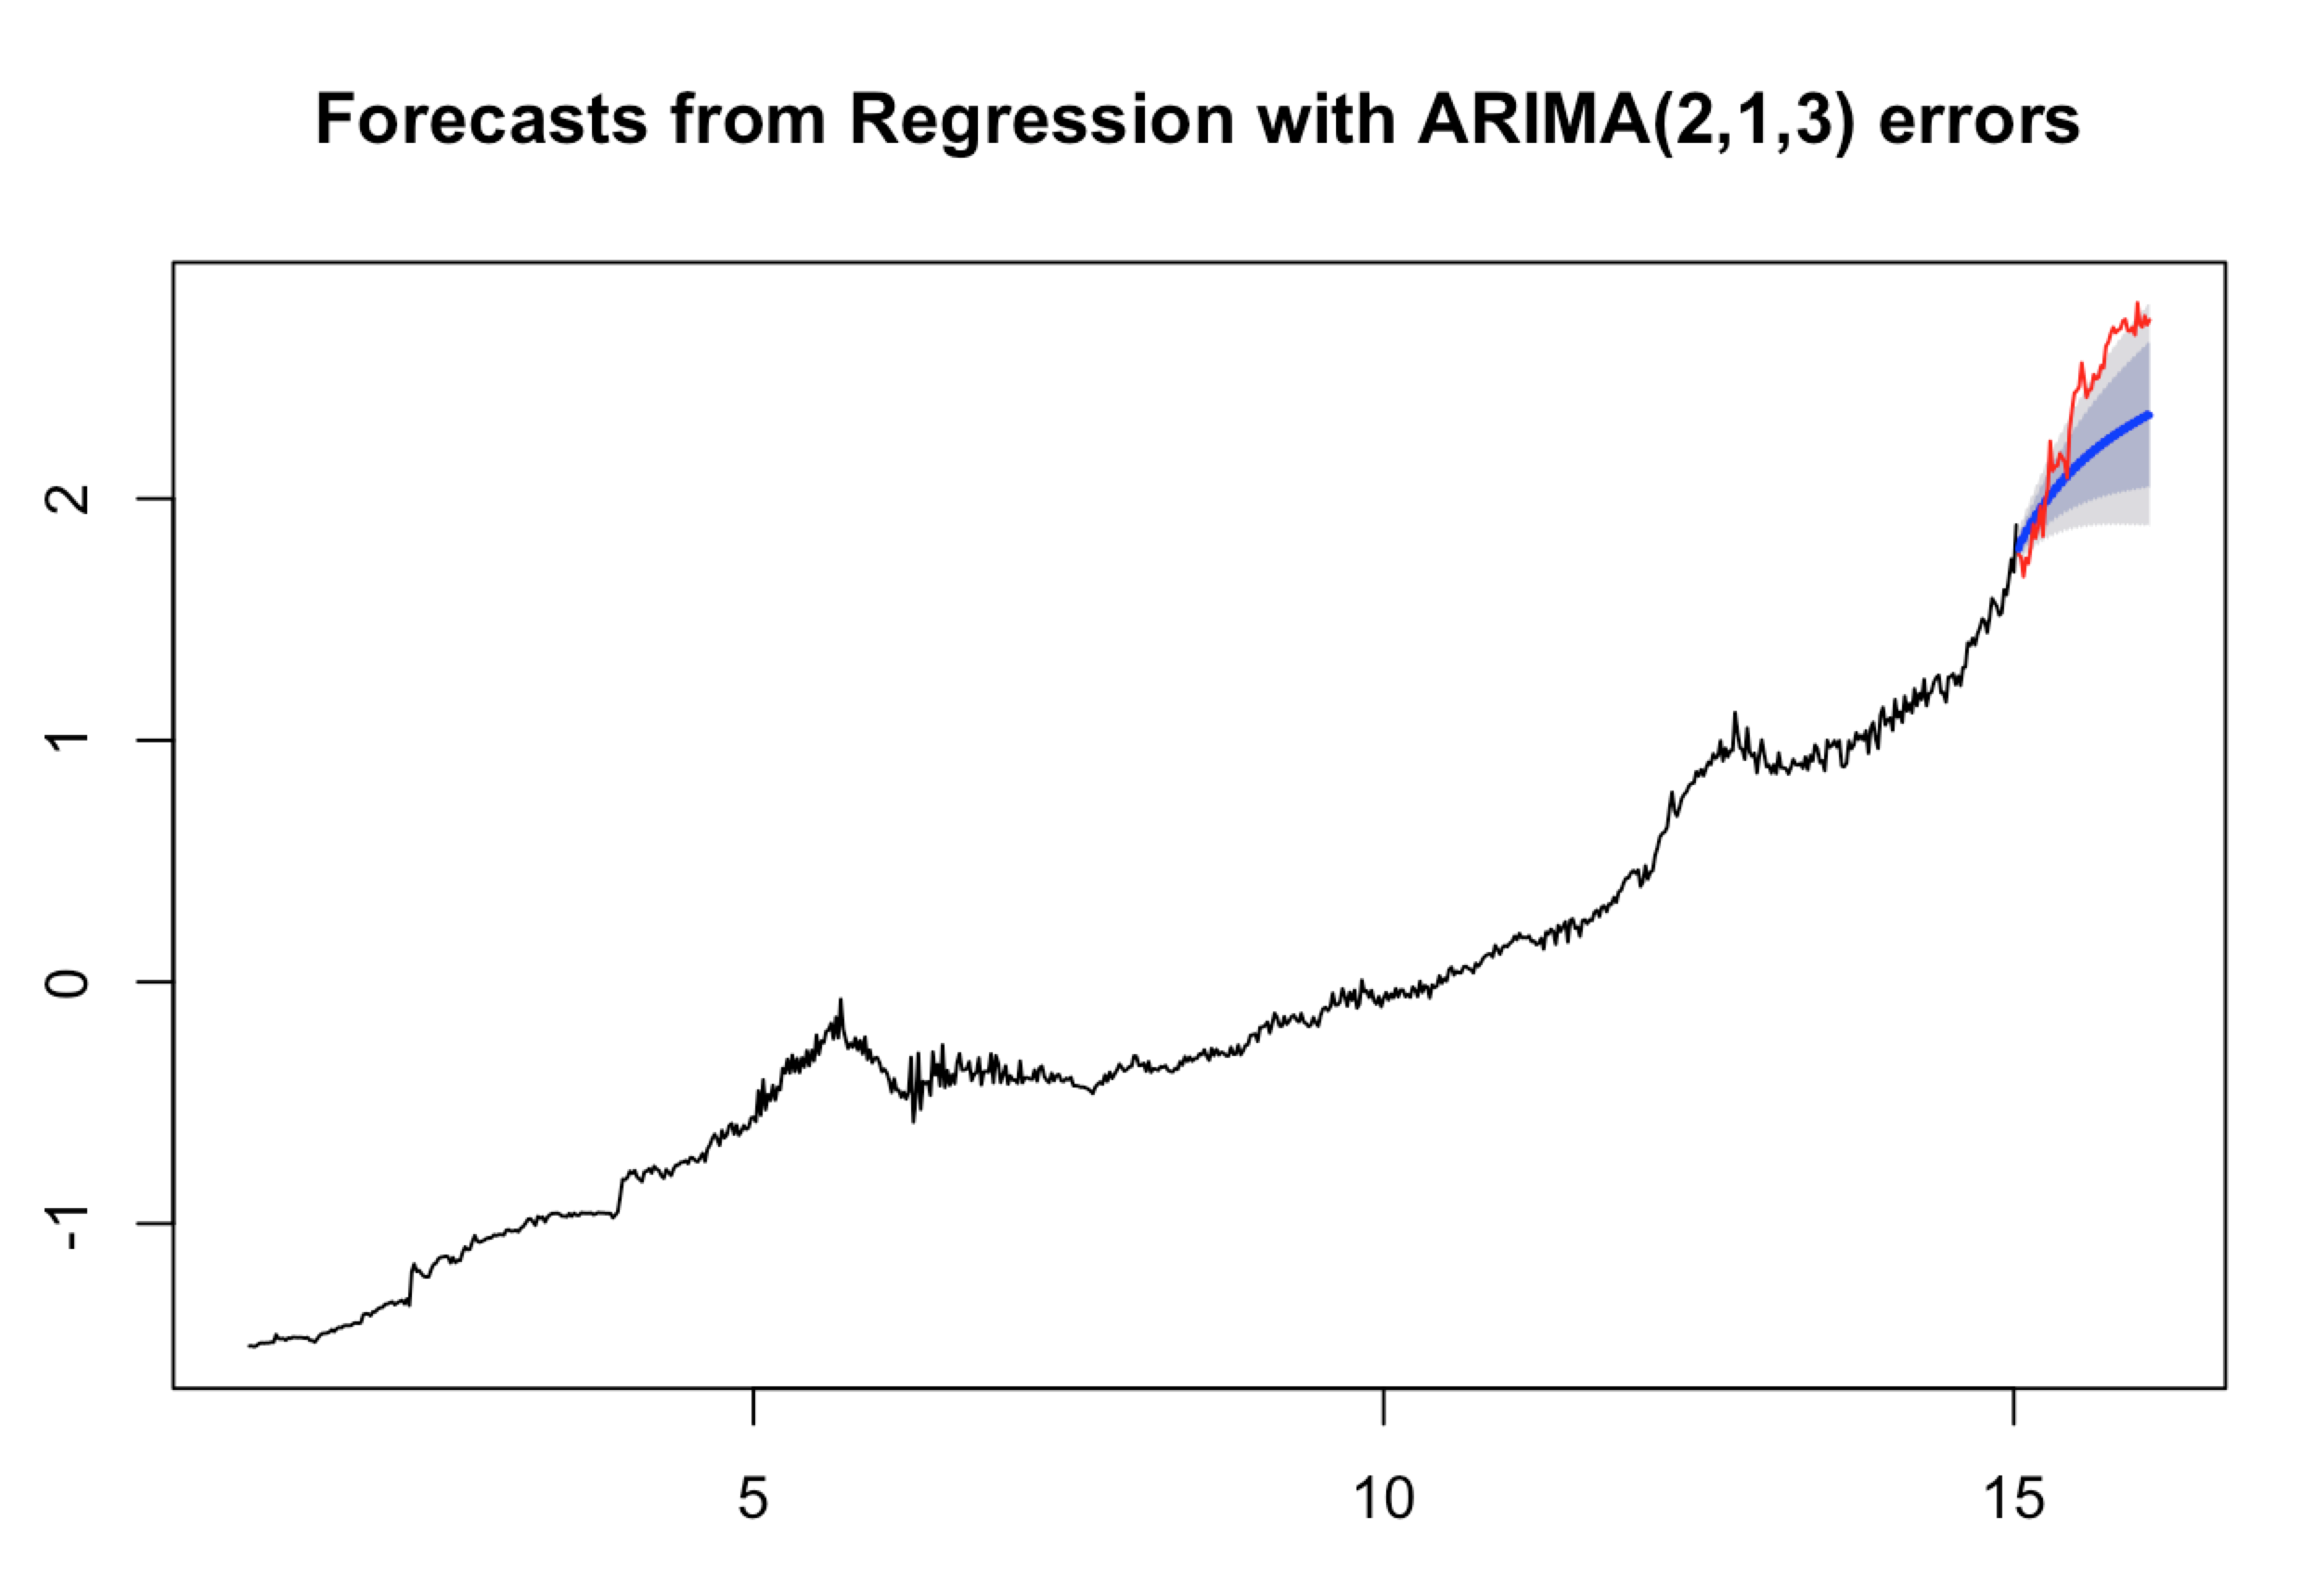
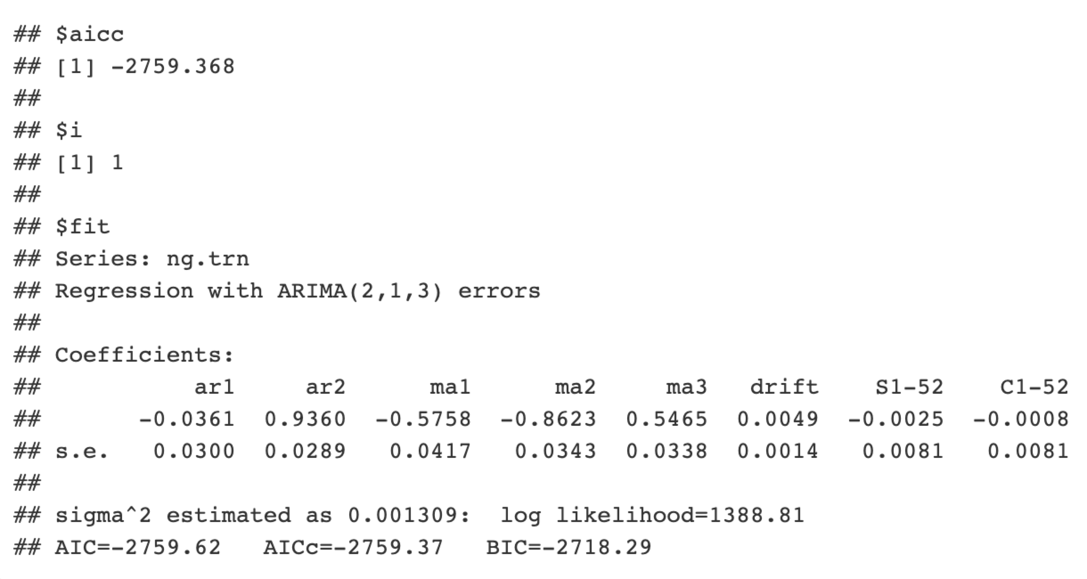
Natural Gas
Notes:
k=1
p-value = 0.08053

Slide 21
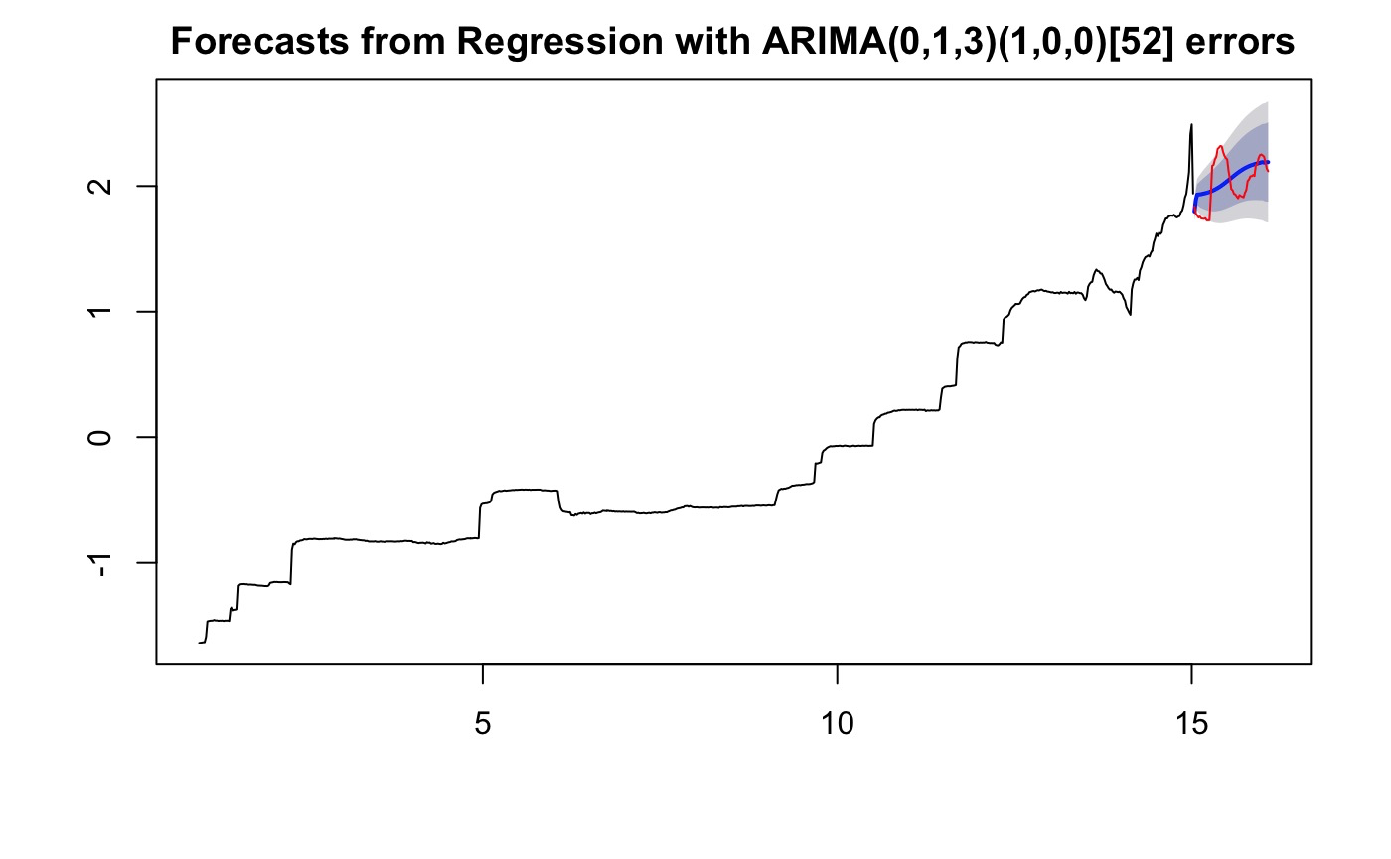
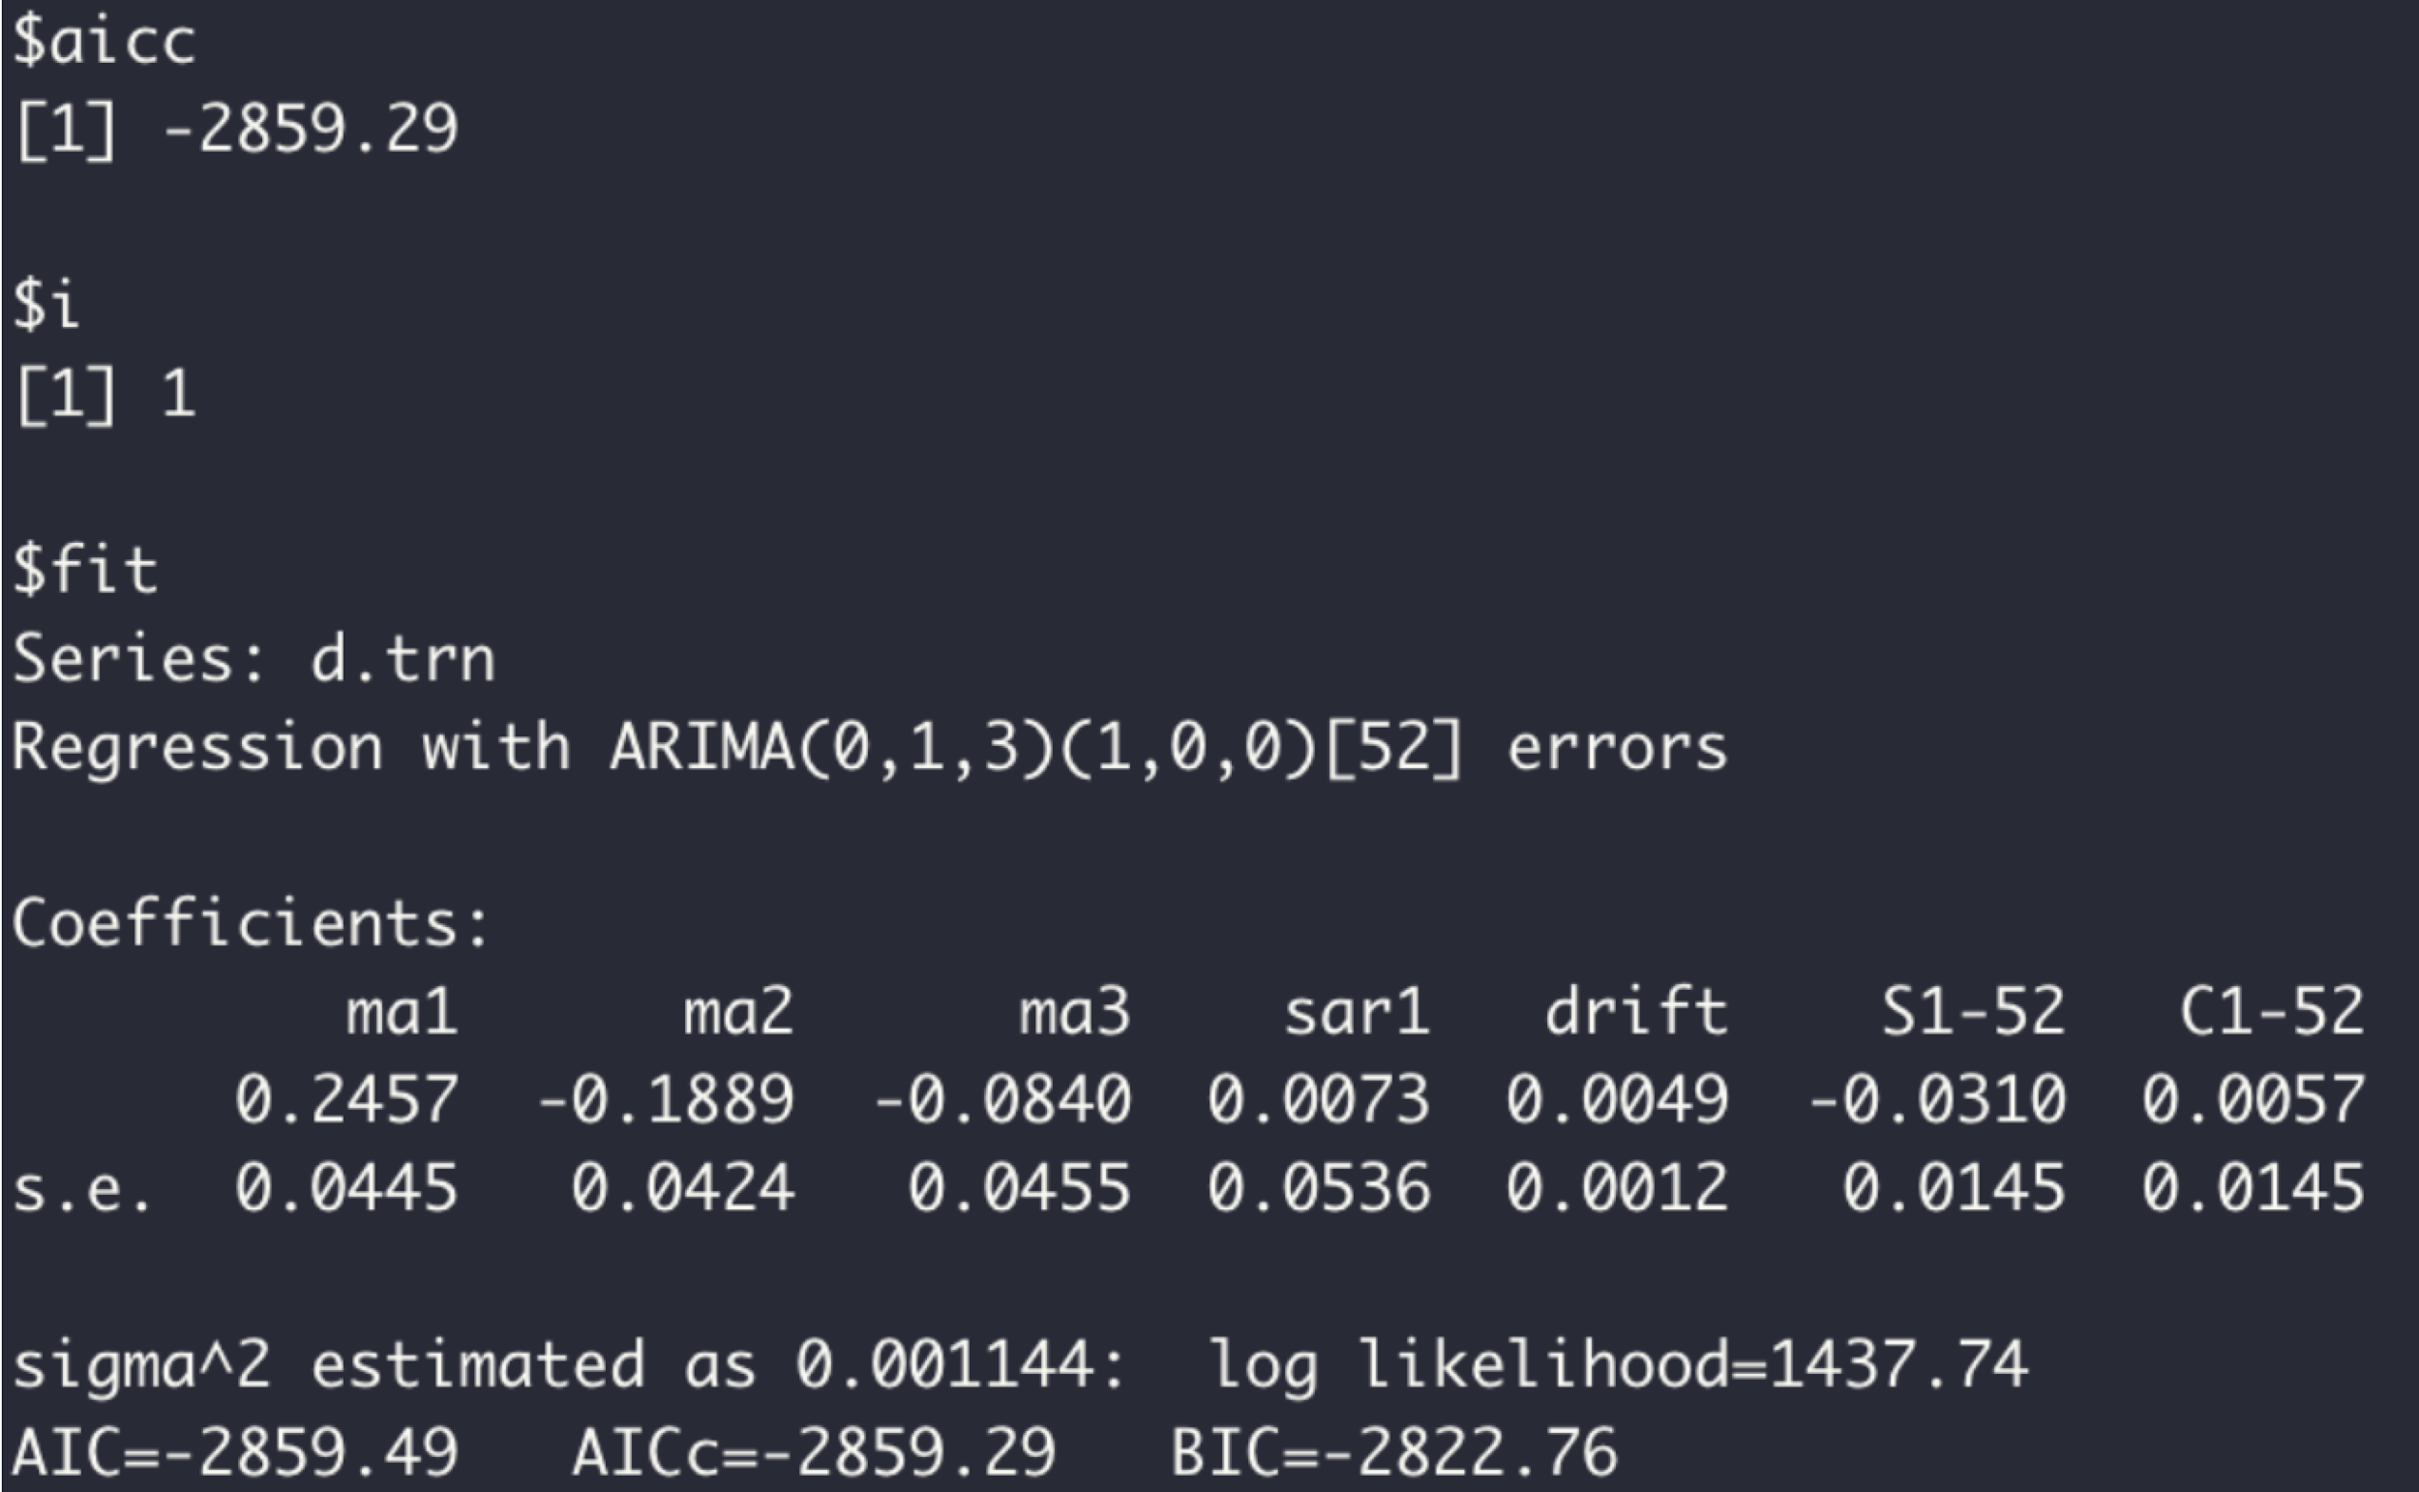
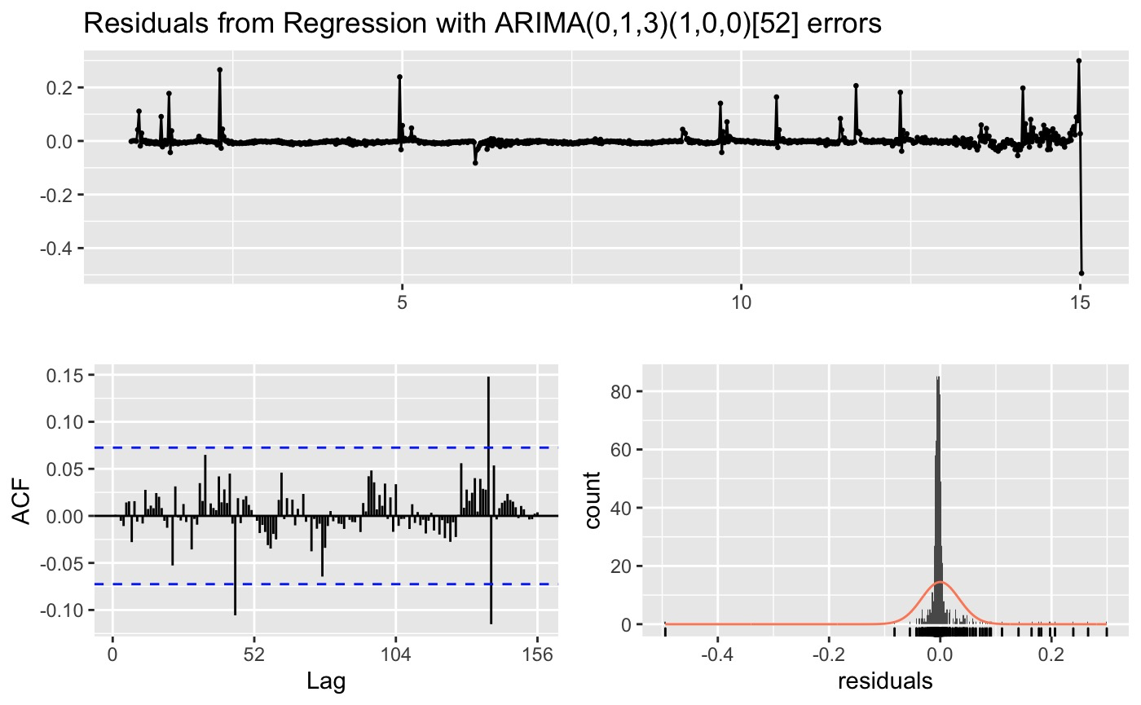
Diesel
Notes:
K =1

Slide 22
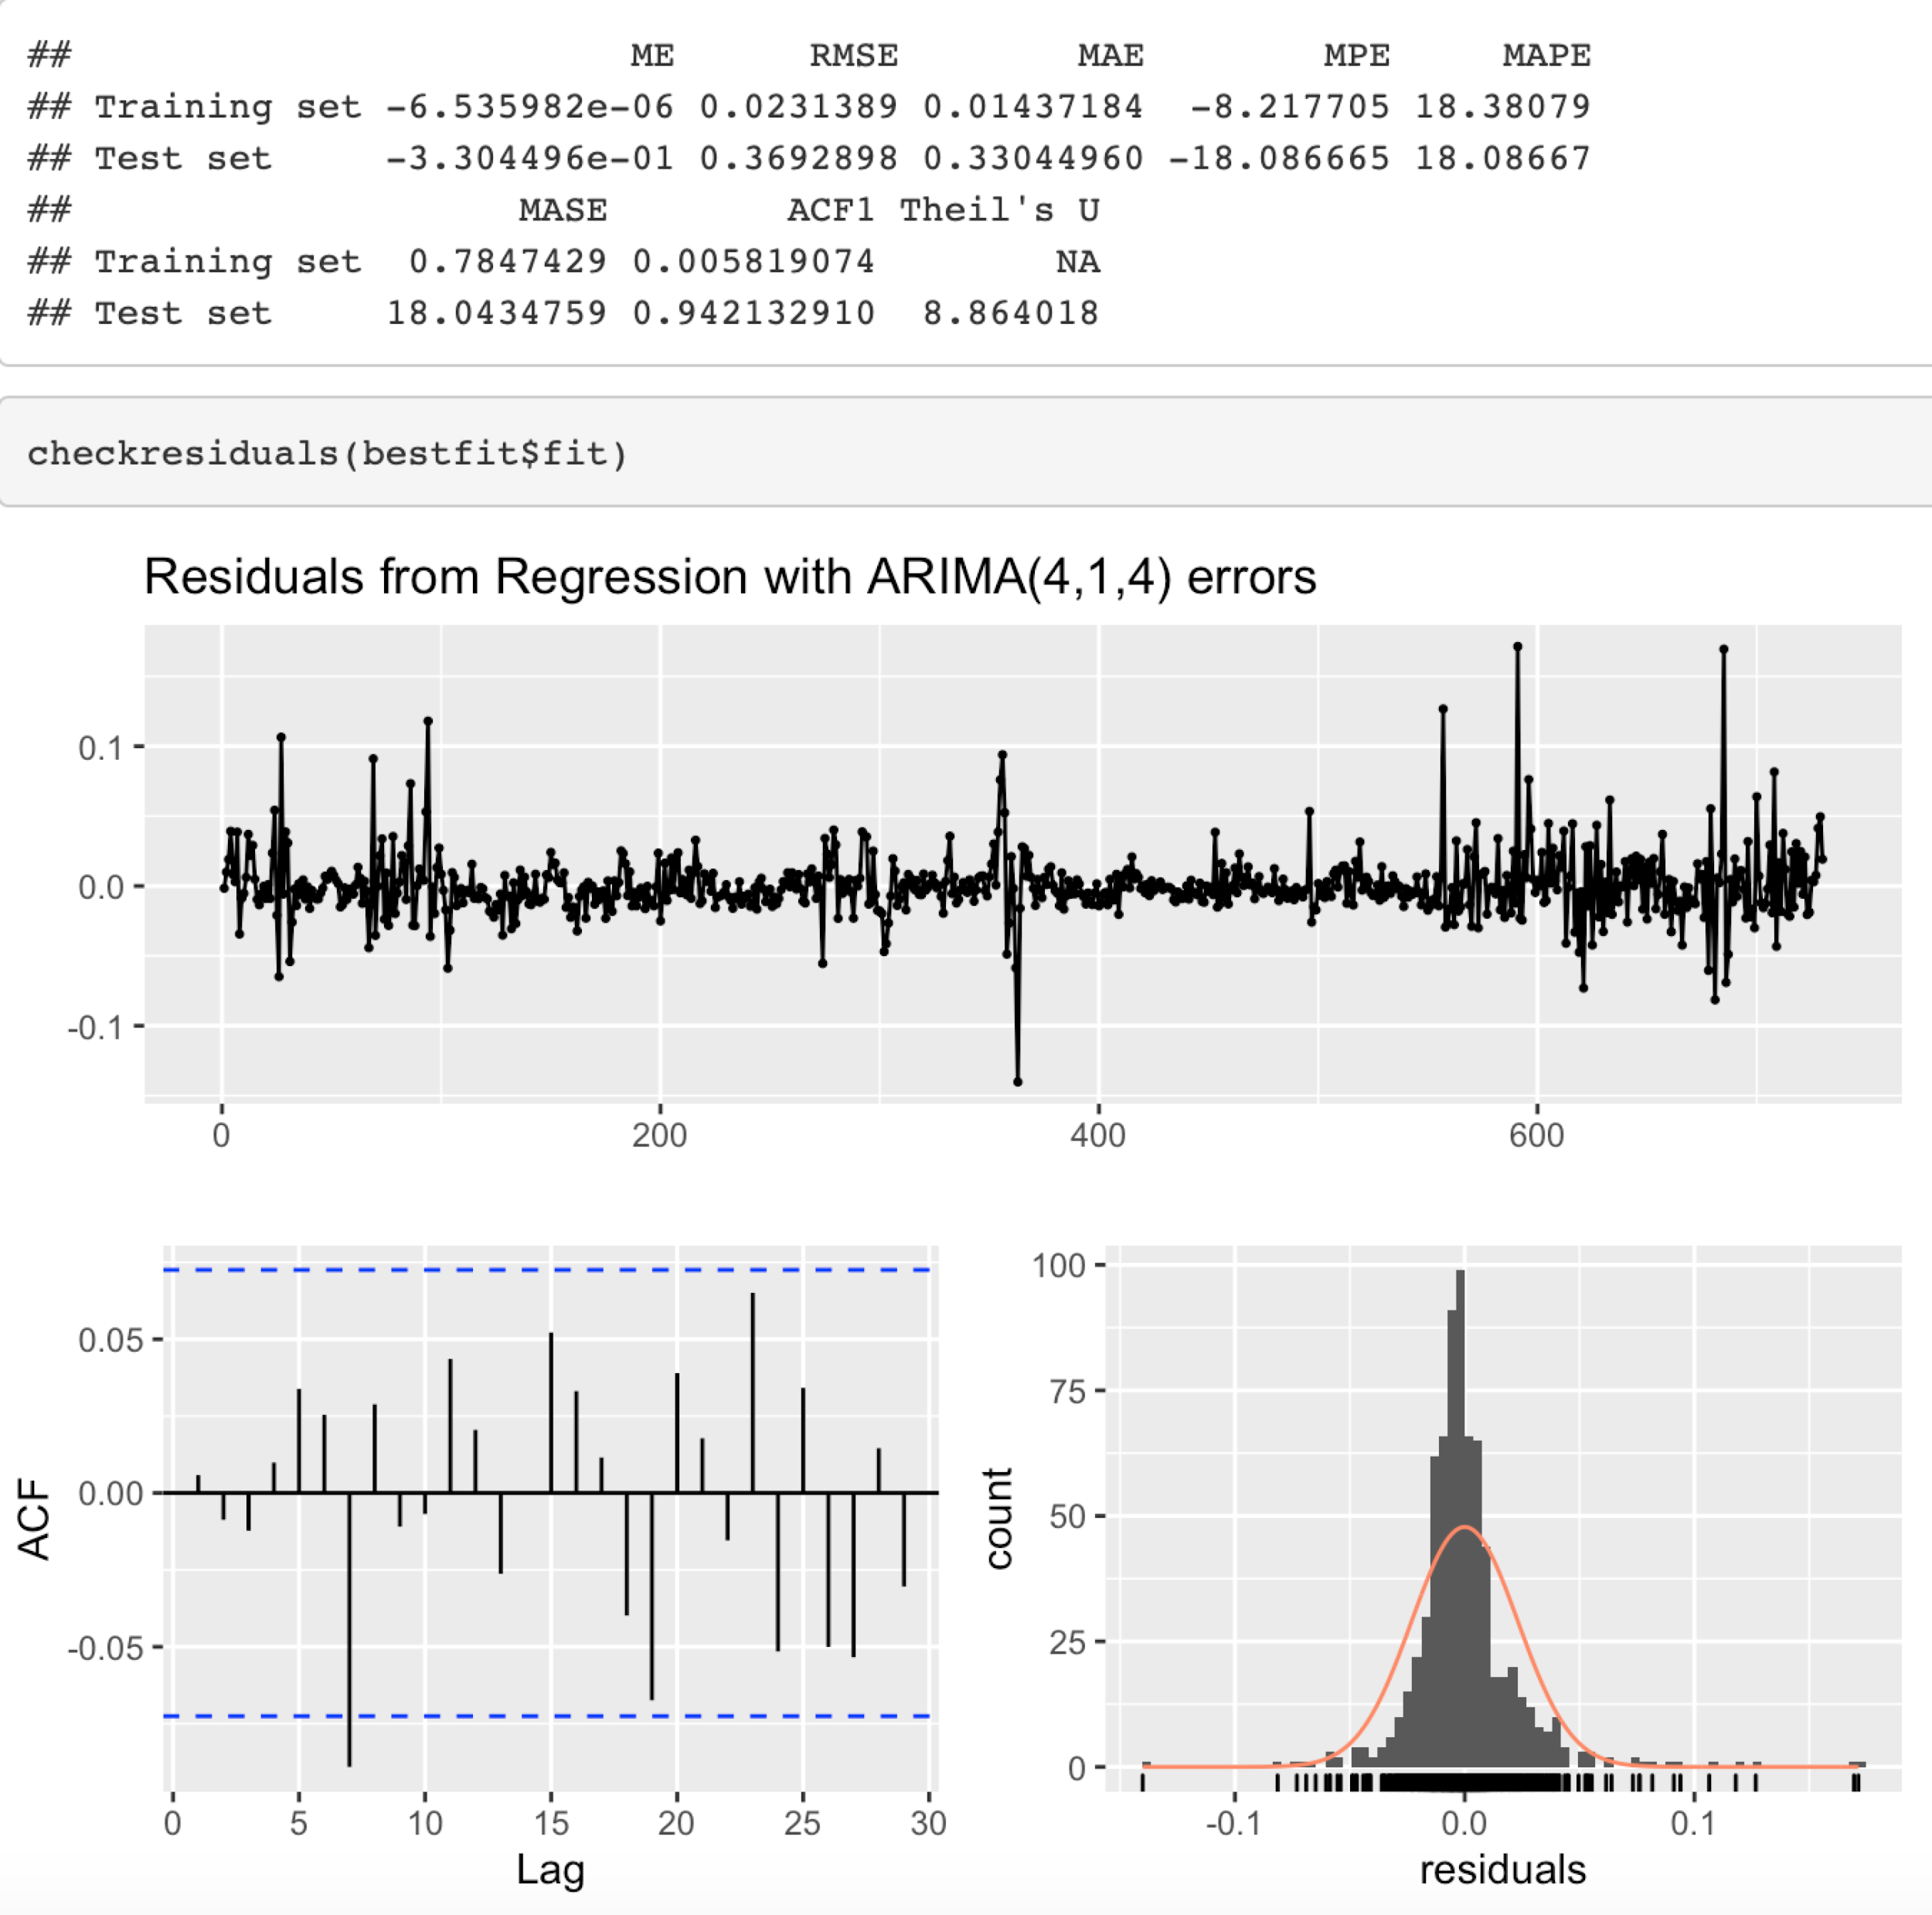
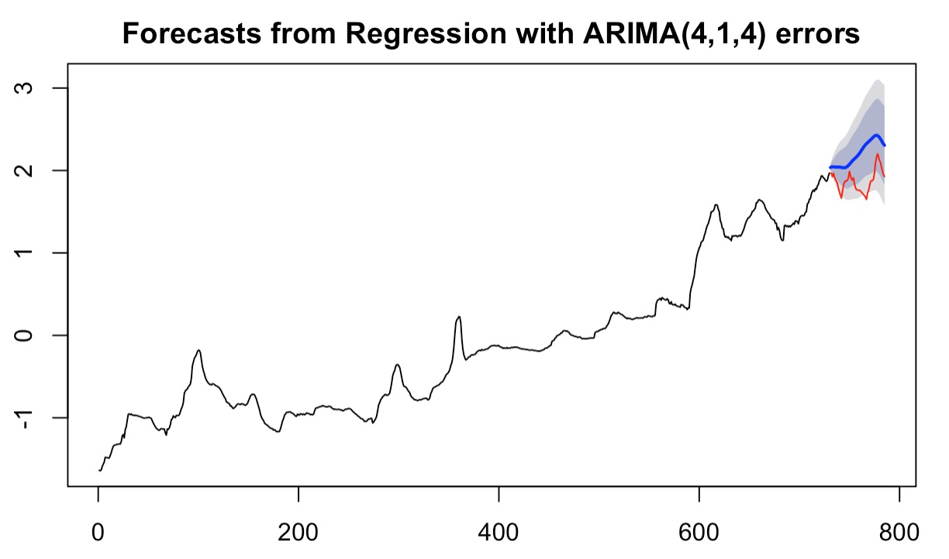
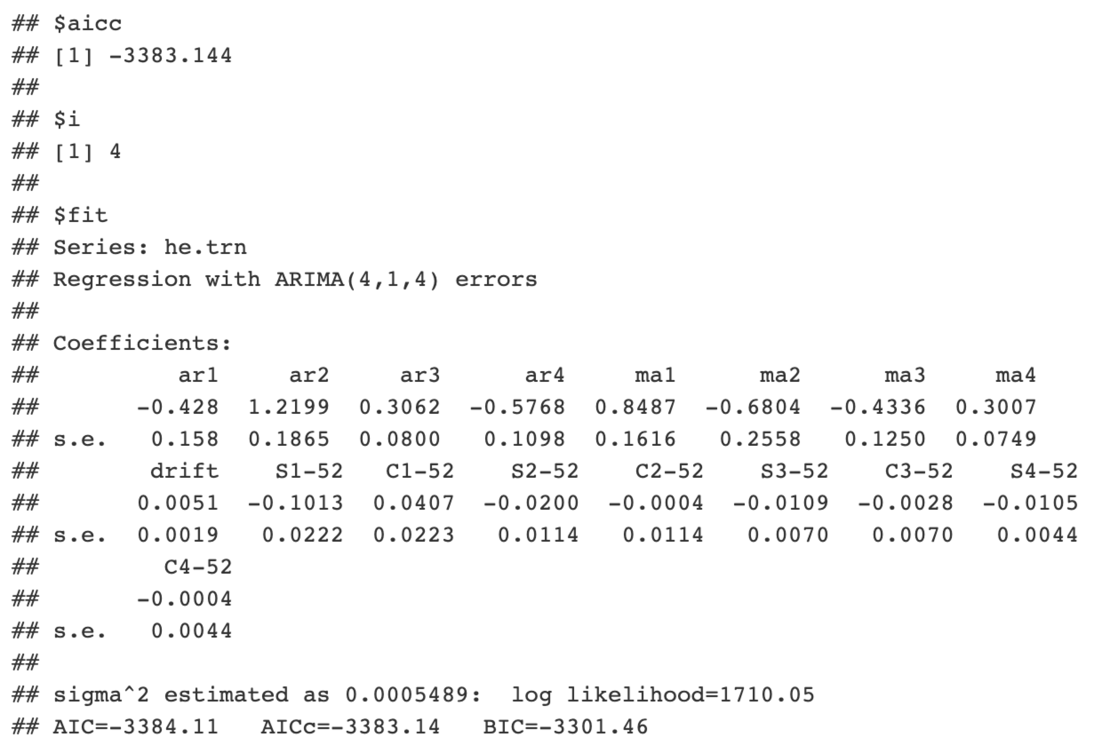
Hydrous Ethanol
Notes:
K =4
p-value = 0.0002561=> residuals are stationary
This forecast looks like a pretty good abstraction of the basic seasonal cycle projected into the future.

Slide 23
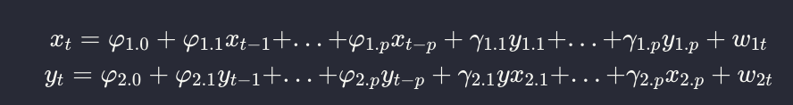
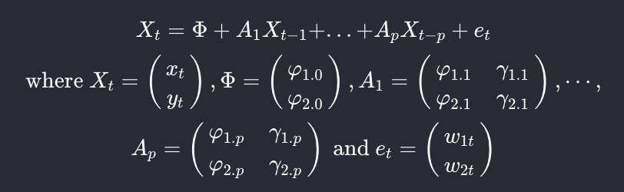
VAR-Multivariate Analysis

Slide 24
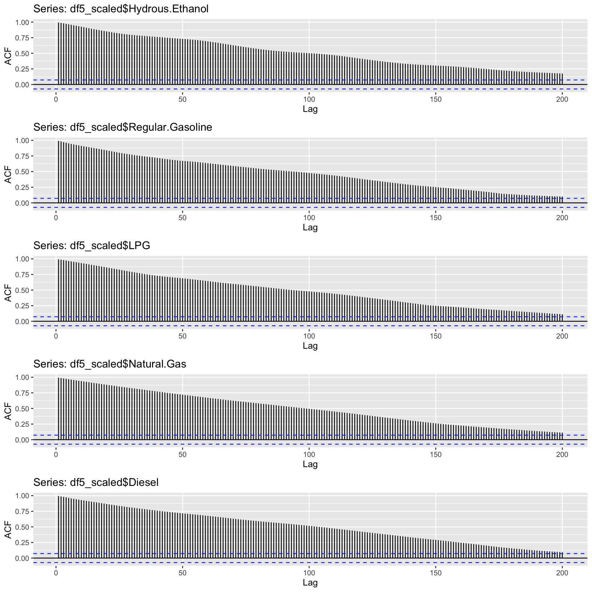
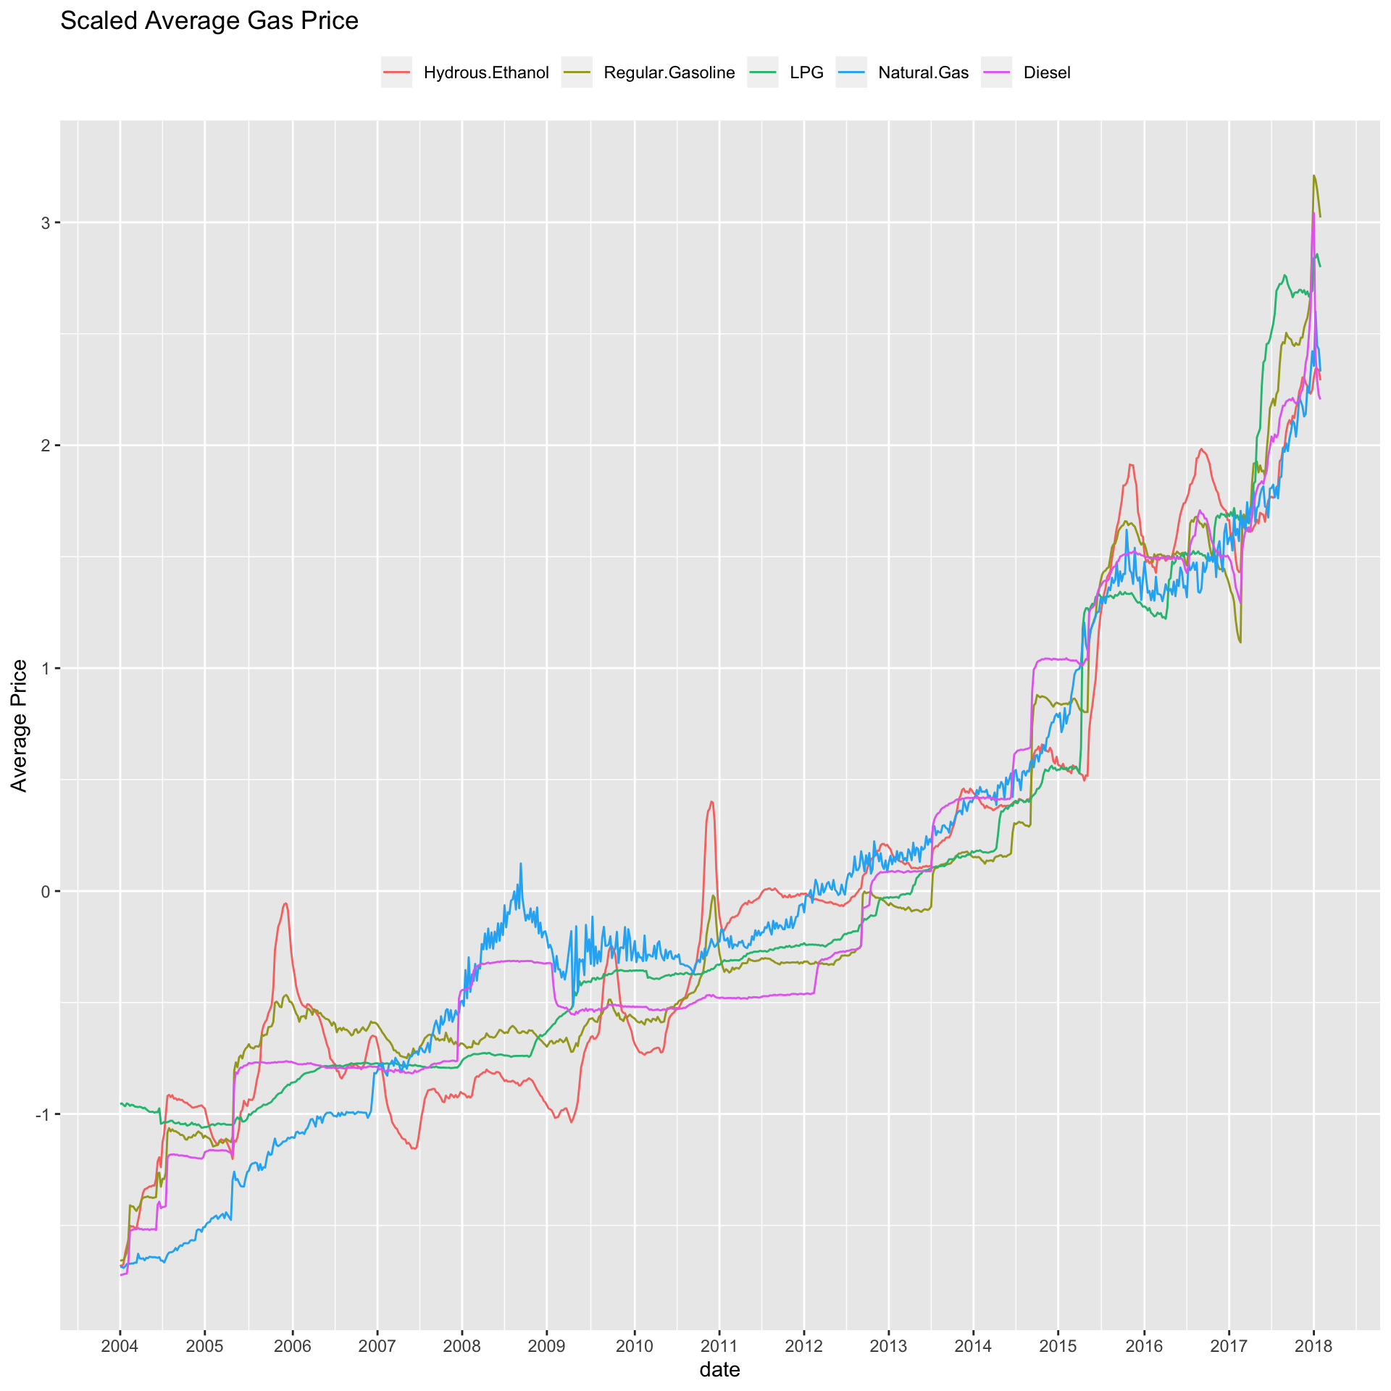
Average Price of each products
Normalized data

Slide 25


Average Price of each products with the first differencing
Normalized data

Slide 26


Normalized data

Slide 27


VAR: product price as exogenous variables
Significant regressors for
LPG:
Natural.Gas.l1
Natural.Gas.l2
Natural.Gas.l3
Diesel.l3

Slide 28


VAR: other gas price information as exogenous variables
Significant regressors for
diesel:
Max_price.lag1
Avg_price.lag1
Coef_dist.lag1

Slide 29
VAR: Summary
Model 1:
Choosing other products price as exogenous variables
Hydrous Ethanol; Regular Gasoline; LPG and Diesel have higher accuracy by this model
Model 2:
Choosing other price info as exogenous variables
Max price, min price, average price and standard deviation price in each week
Natural Gas has higher accuracy by this model,

Slide 30
Result comparison
Hydrous Ethanol: Arima+Garch
Natural Gas: Arima+Fourier term
Regular Gasoline: VAR
LPG: similar accuracy among 3 models
(slightly better with Arima+Fourier term)
Diesel: Arima+Fourier term
Overall, the second model returns the better result.
Test error for Regular .Gasoline
Test error for Natural .Gas
Natural .Gas
Regular .Gasoline
 | Model 1 | Model 2 | Model 3
RMSE | 0.542 | 0.2951 | 0.3775
MAE | 0.356 | 0.2537 | 0.3354
MAPE | 24.47 | 10.0952 | 15.1049
 | Model 1 | Model 2 | Model 3
RMSE | 0.3676 | 0.4476 | 0.3139
MAE | 0.2834 | 0.3673 | 0.2635
MAPE | 19.2090 | 17.4477 | 5.9928

Slide 31

Conclusion
Weak seasonality
The second model returns the relatively better results.
Stable upward trend
Inflation is responsible for it.
Gas products
All impacted by the crude oil price
Notes:
https://www.forbes.com/sites/judeclemente/2019/02/07/the-surprisingly-low-seasonality-of-u-s-natural-gas-prices/#7e958111f4a8
https://www.fuelexpress.net/blog/general-information/gasoline-vs-natural-gas/

Slide 32
？

Slide 33


Products’ Average Price

Slide 34



ARIMA

Slide 35
Notes:
NG：

